Slide 1


Slide 2
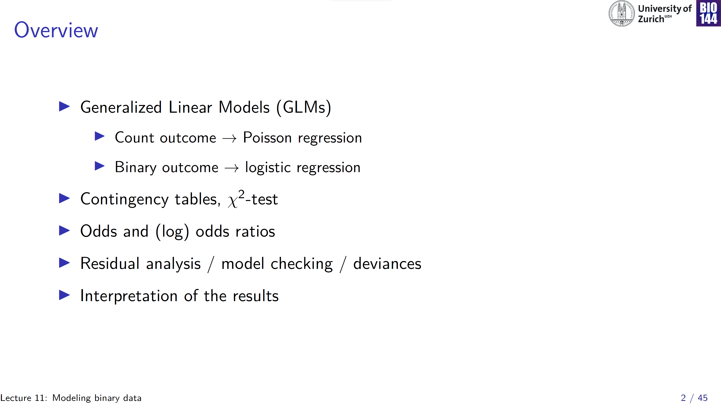

Slide 3
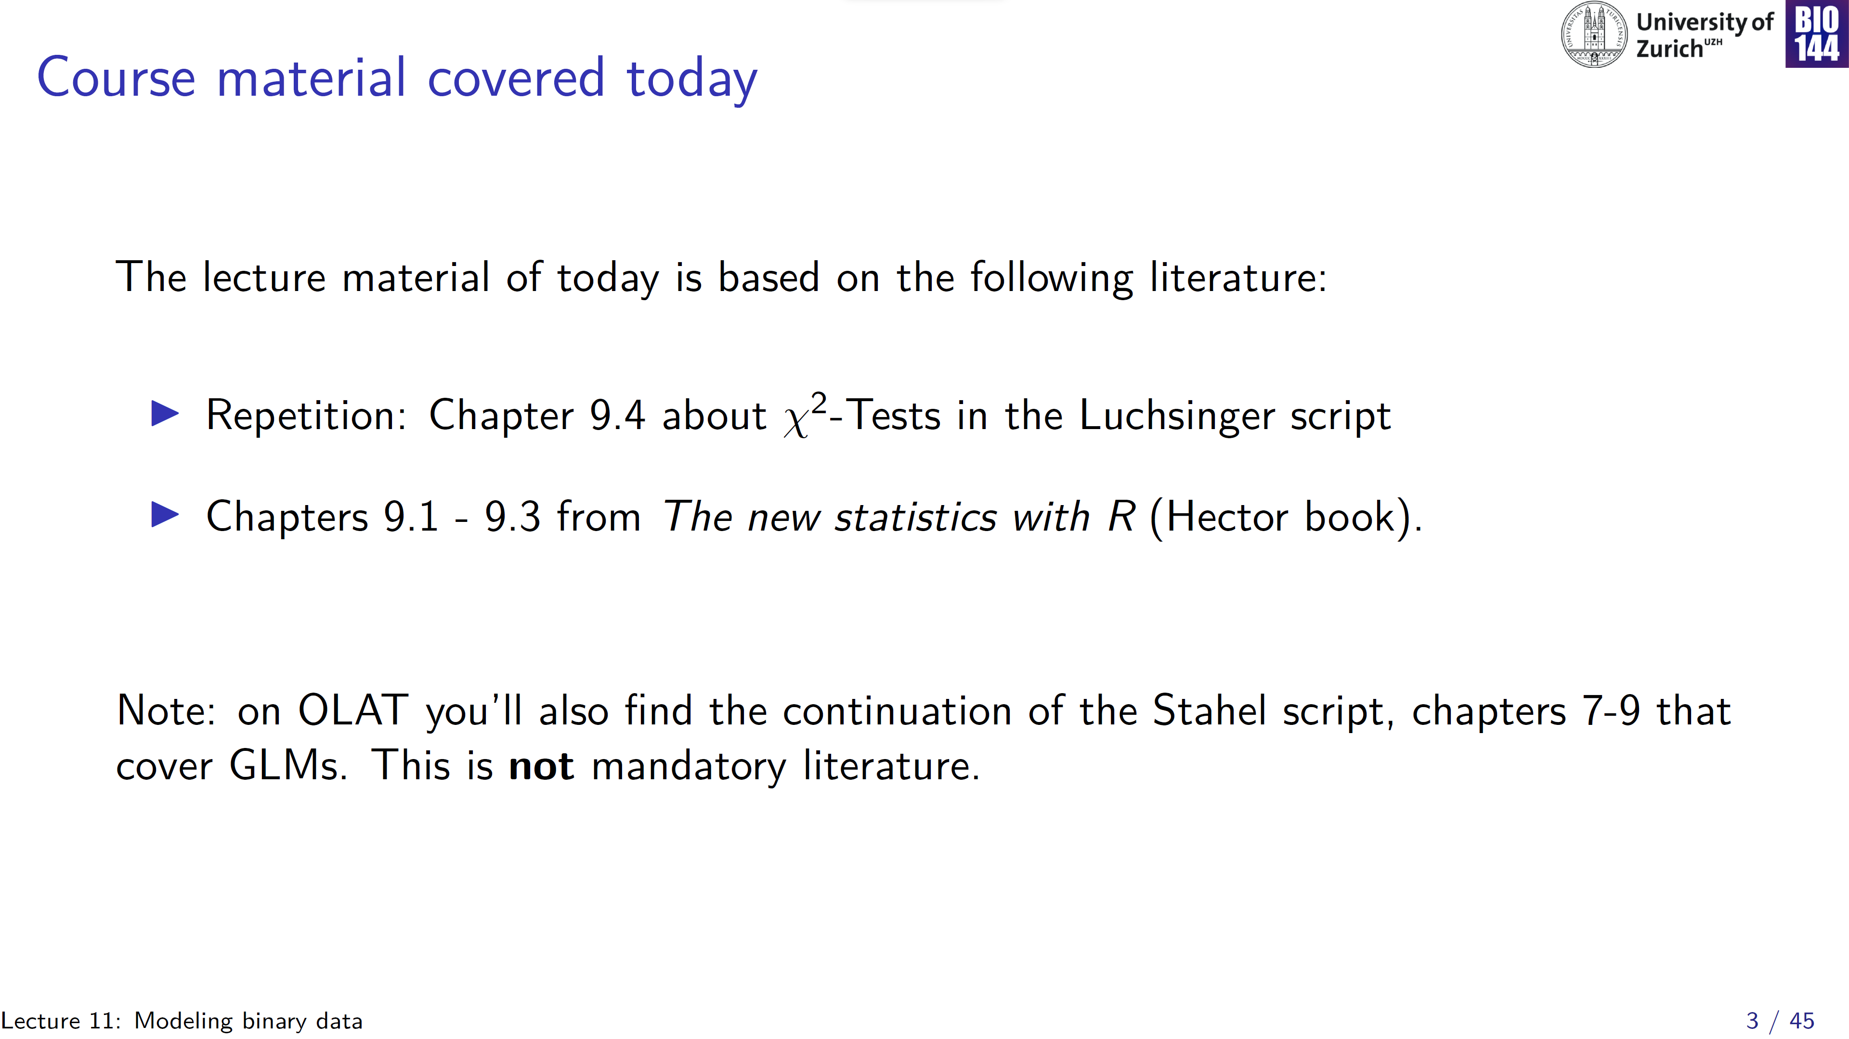

Slide 4
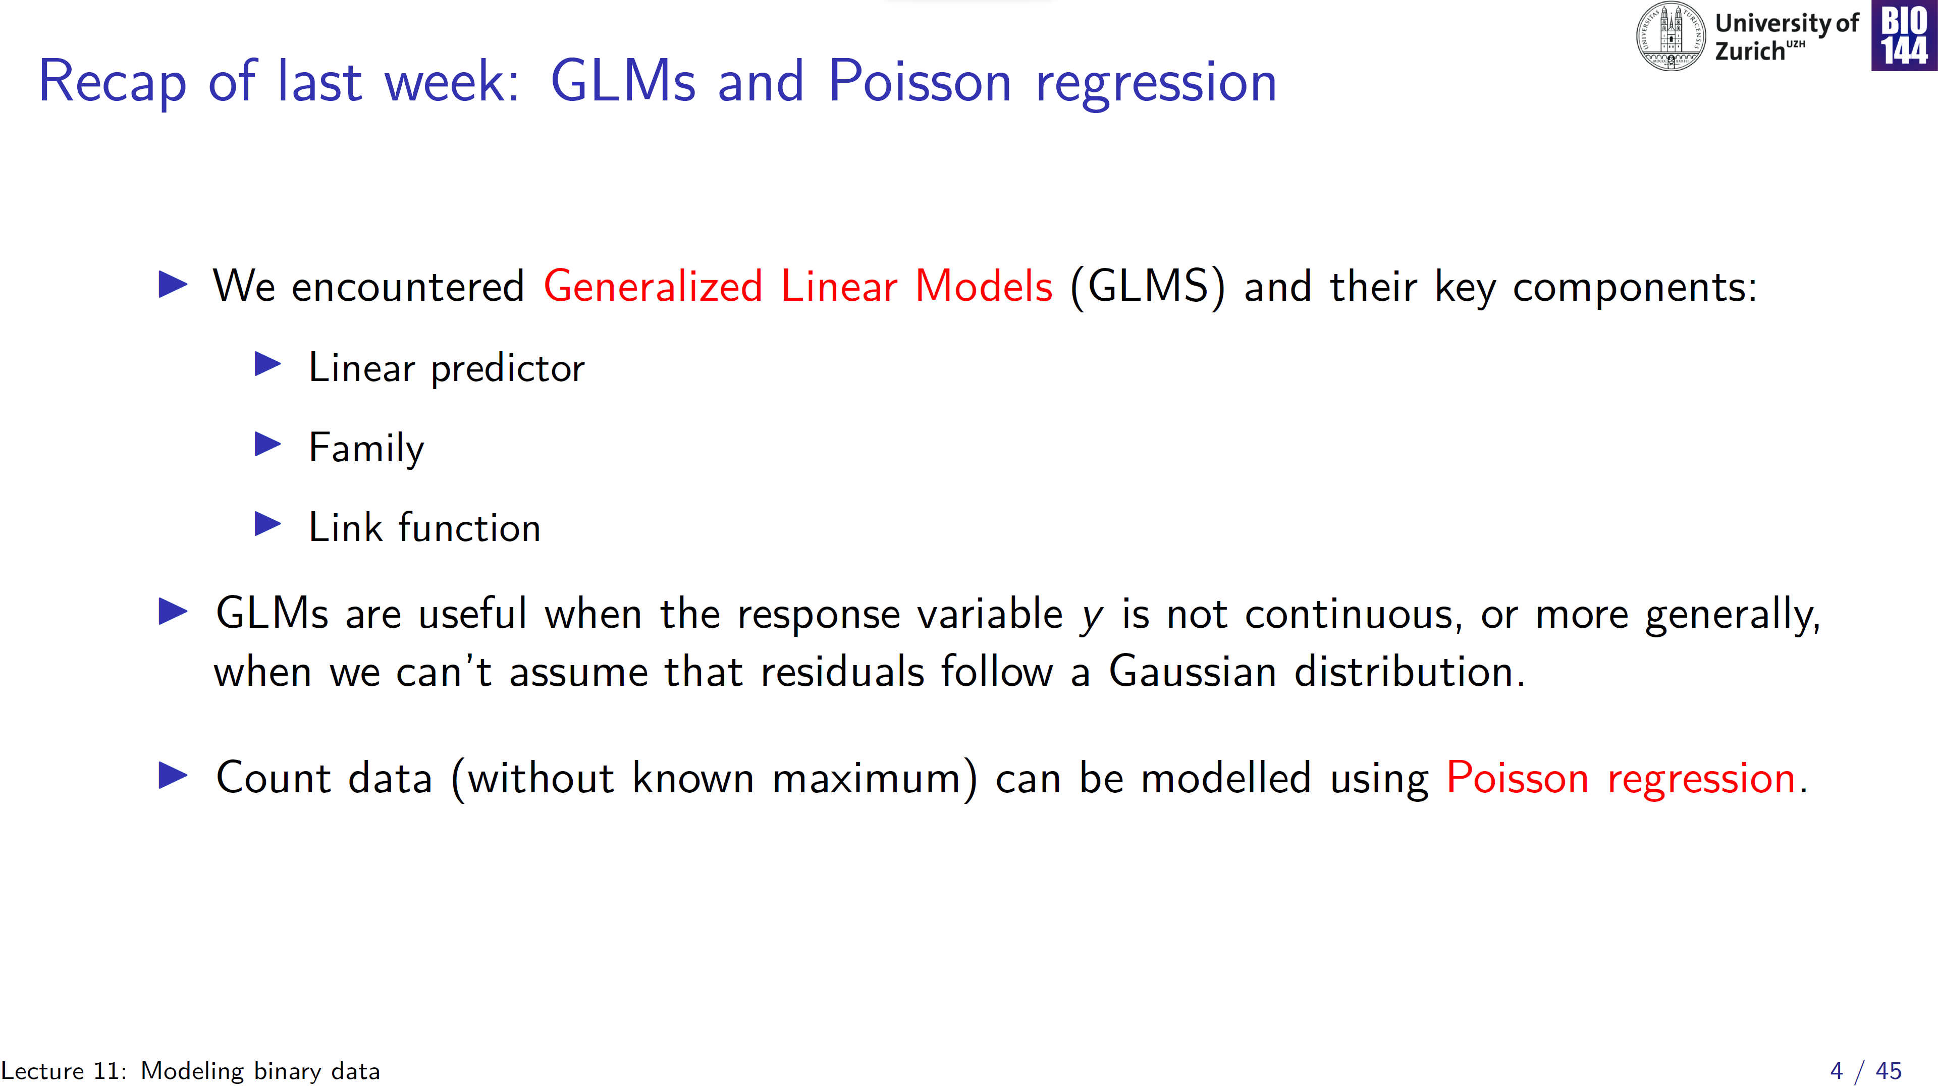
η
e.g. Poisson, binomial, …
e.g. log, logit, …

Slide 5
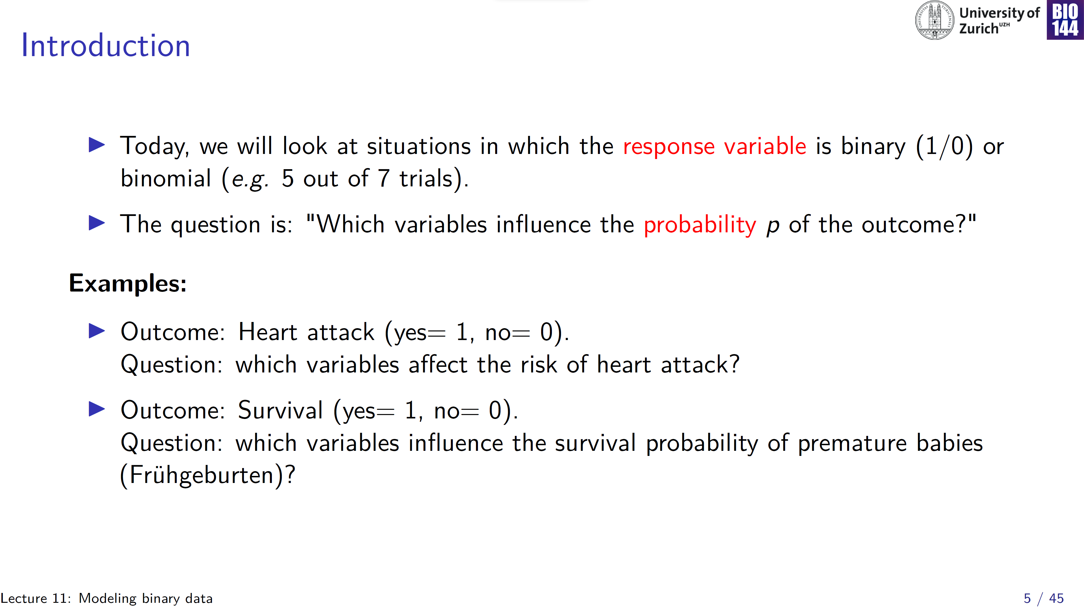

Slide 6
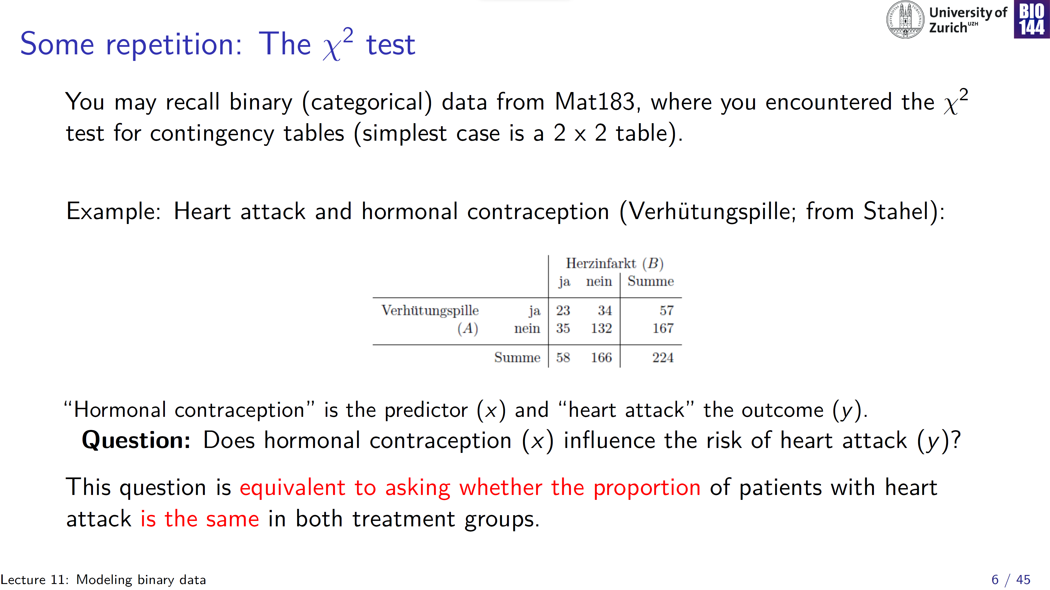
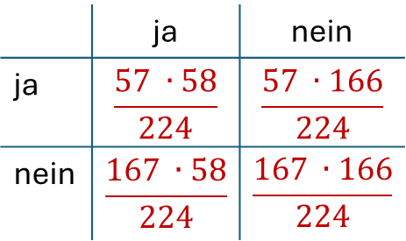
Observed
Expected
 | ja | nein
ja | $$\frac{57 ∙58}{224}$$ | $$\frac{57 ∙166}{224}$$
nein | $$\frac{167 ∙58}{224}$$ | $$\frac{167 ∙166}{224}$$

Slide 7
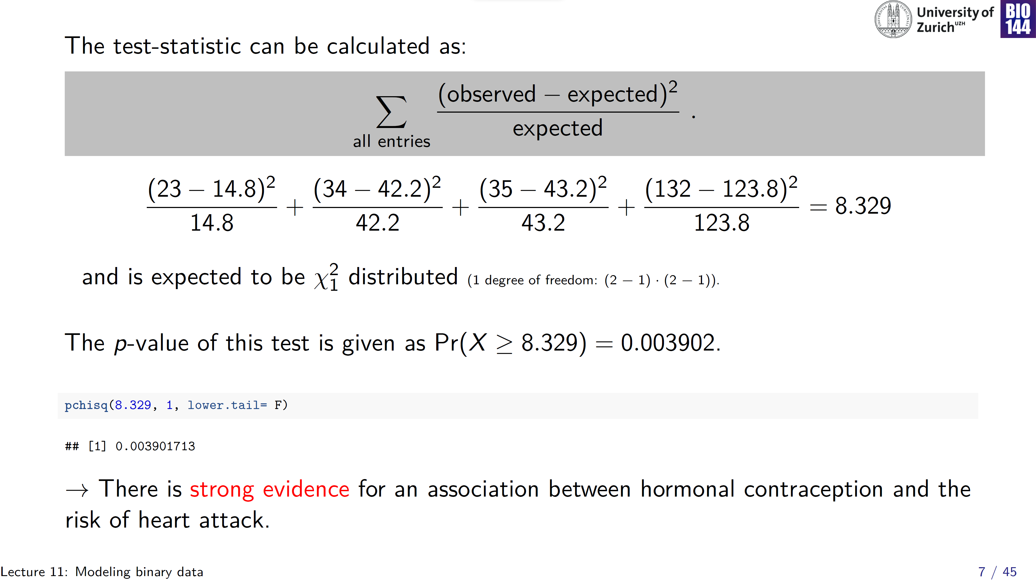
Notes:
Why set lower tail to false? To get probability greater than, or equal to!

Slide 8
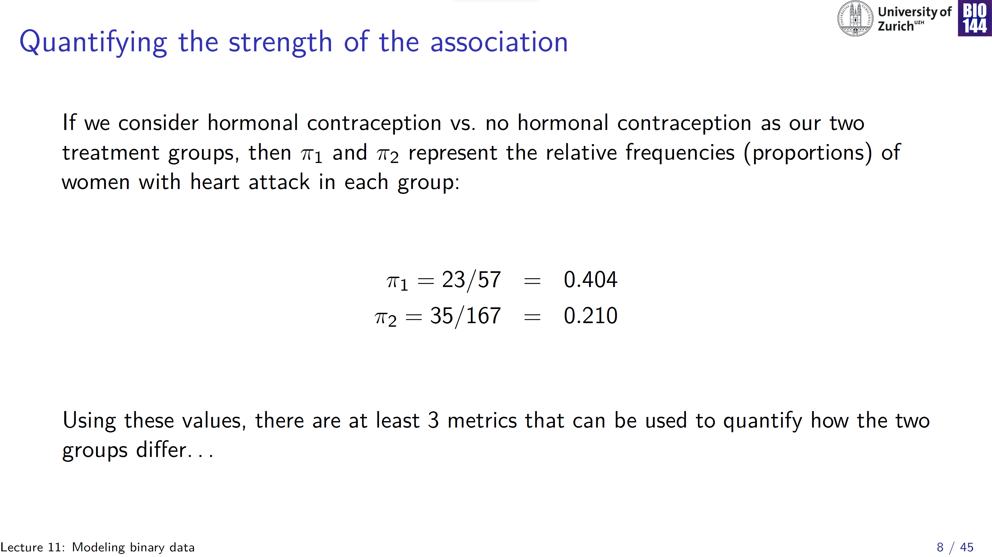

Slide 9
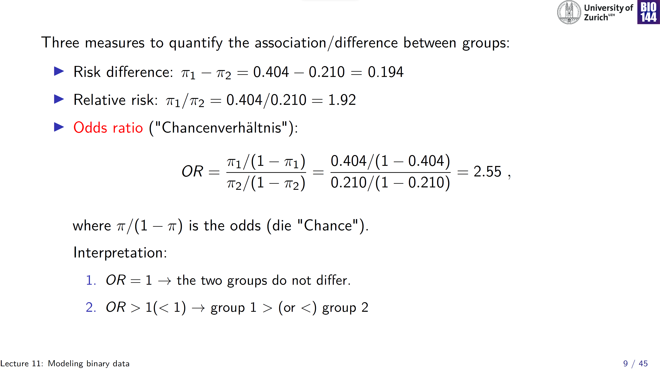

Slide 10
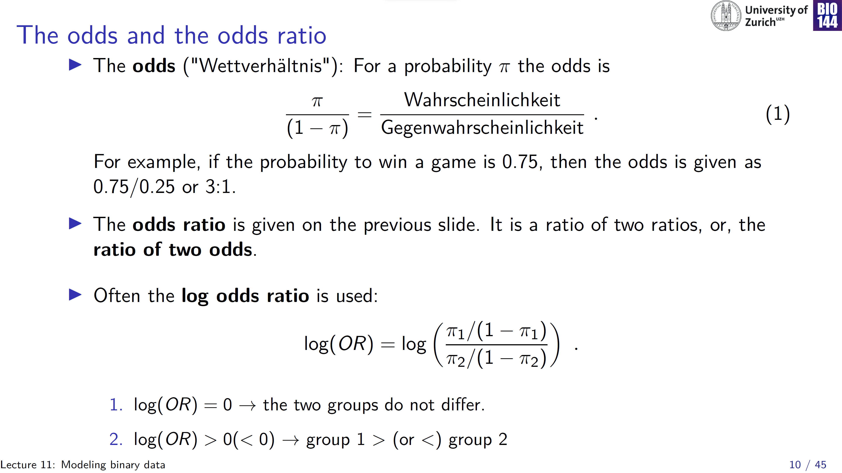
Notes:
In fact, as we will find out in the binomial GLM parameters are estimated at this log odds ratio scale, i.e. the logit transform

Slide 11
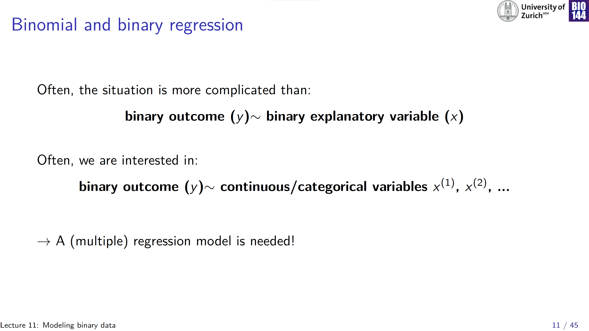

Slide 12
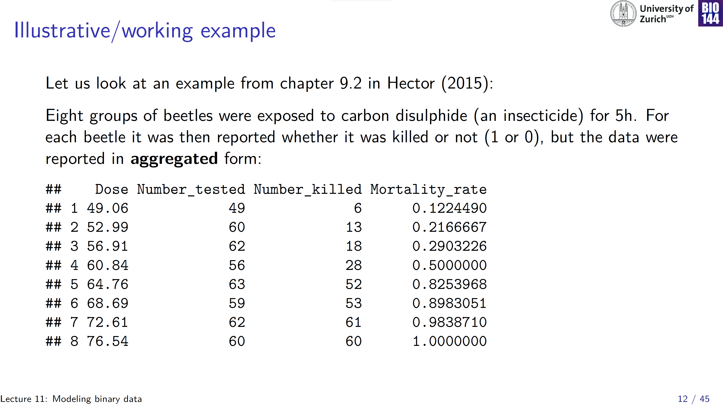
Number_survived
49 – 6= 42
60 – 13= 47
…
Sample size= 471
Notes:
Note that, even though the dataframe only contains 8 rows, the sample size is quite a bit higher -> data summarized in an aggregated form

Slide 13
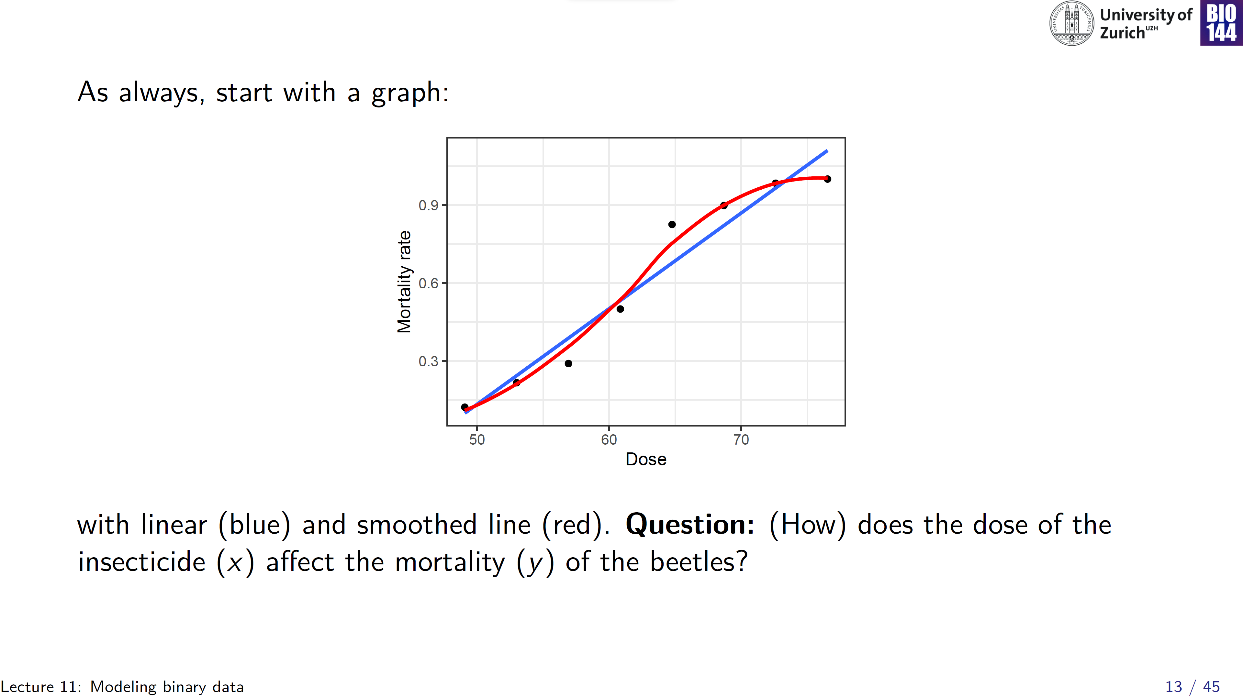
Mortality rate > 1 ?!

Slide 14
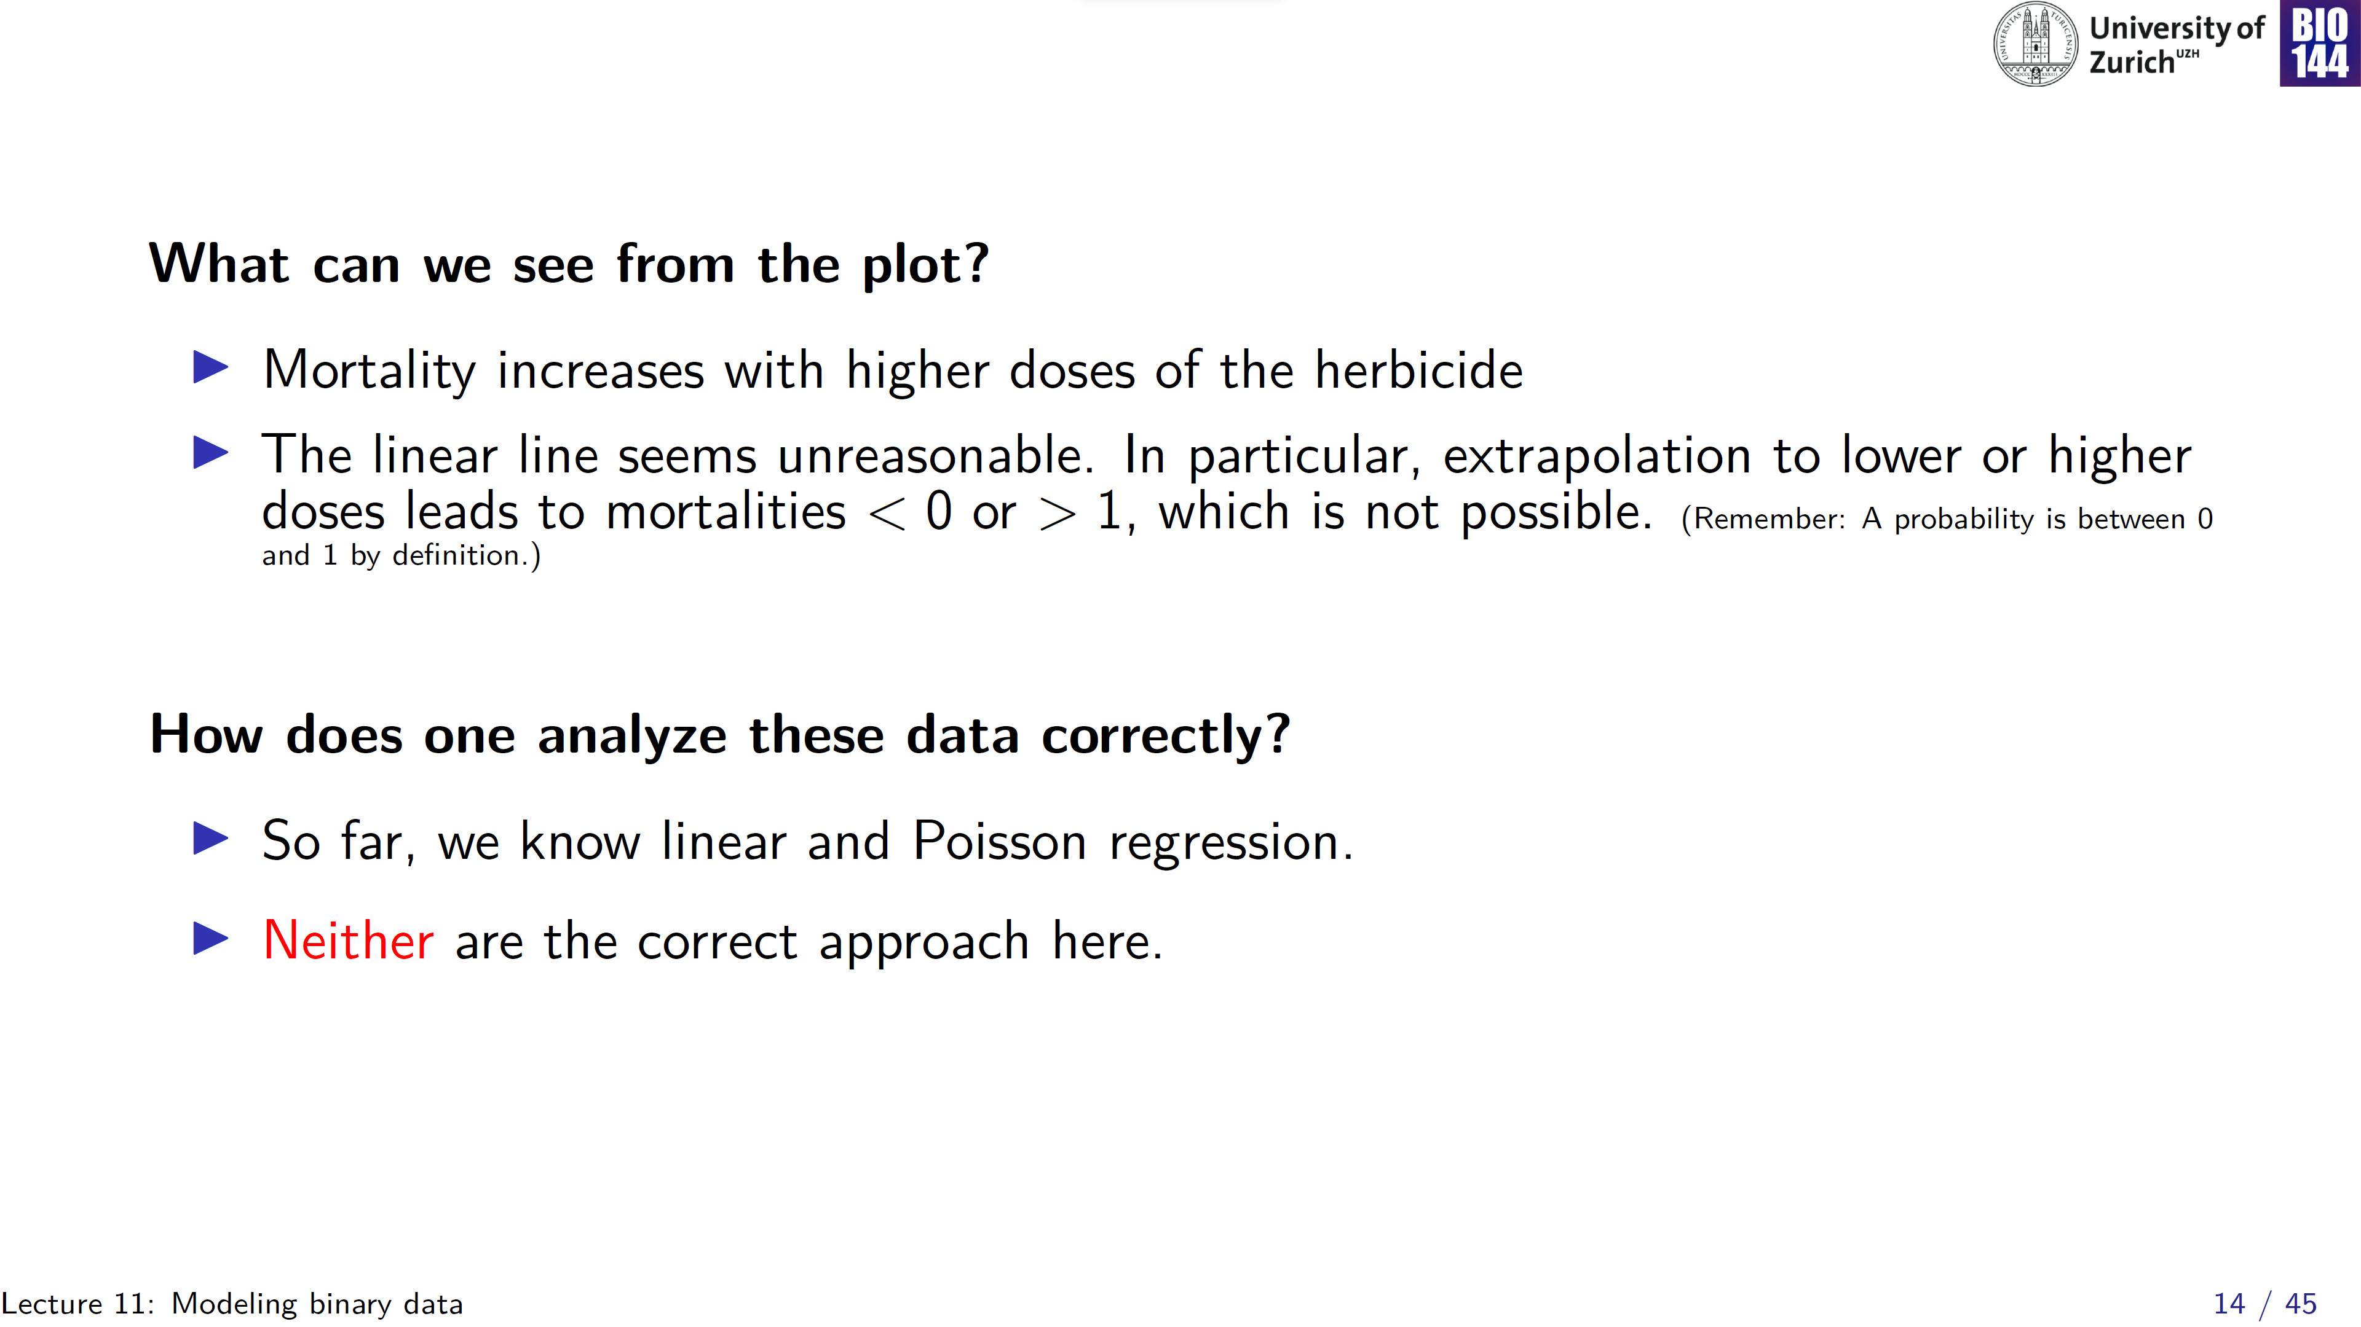

Slide 15
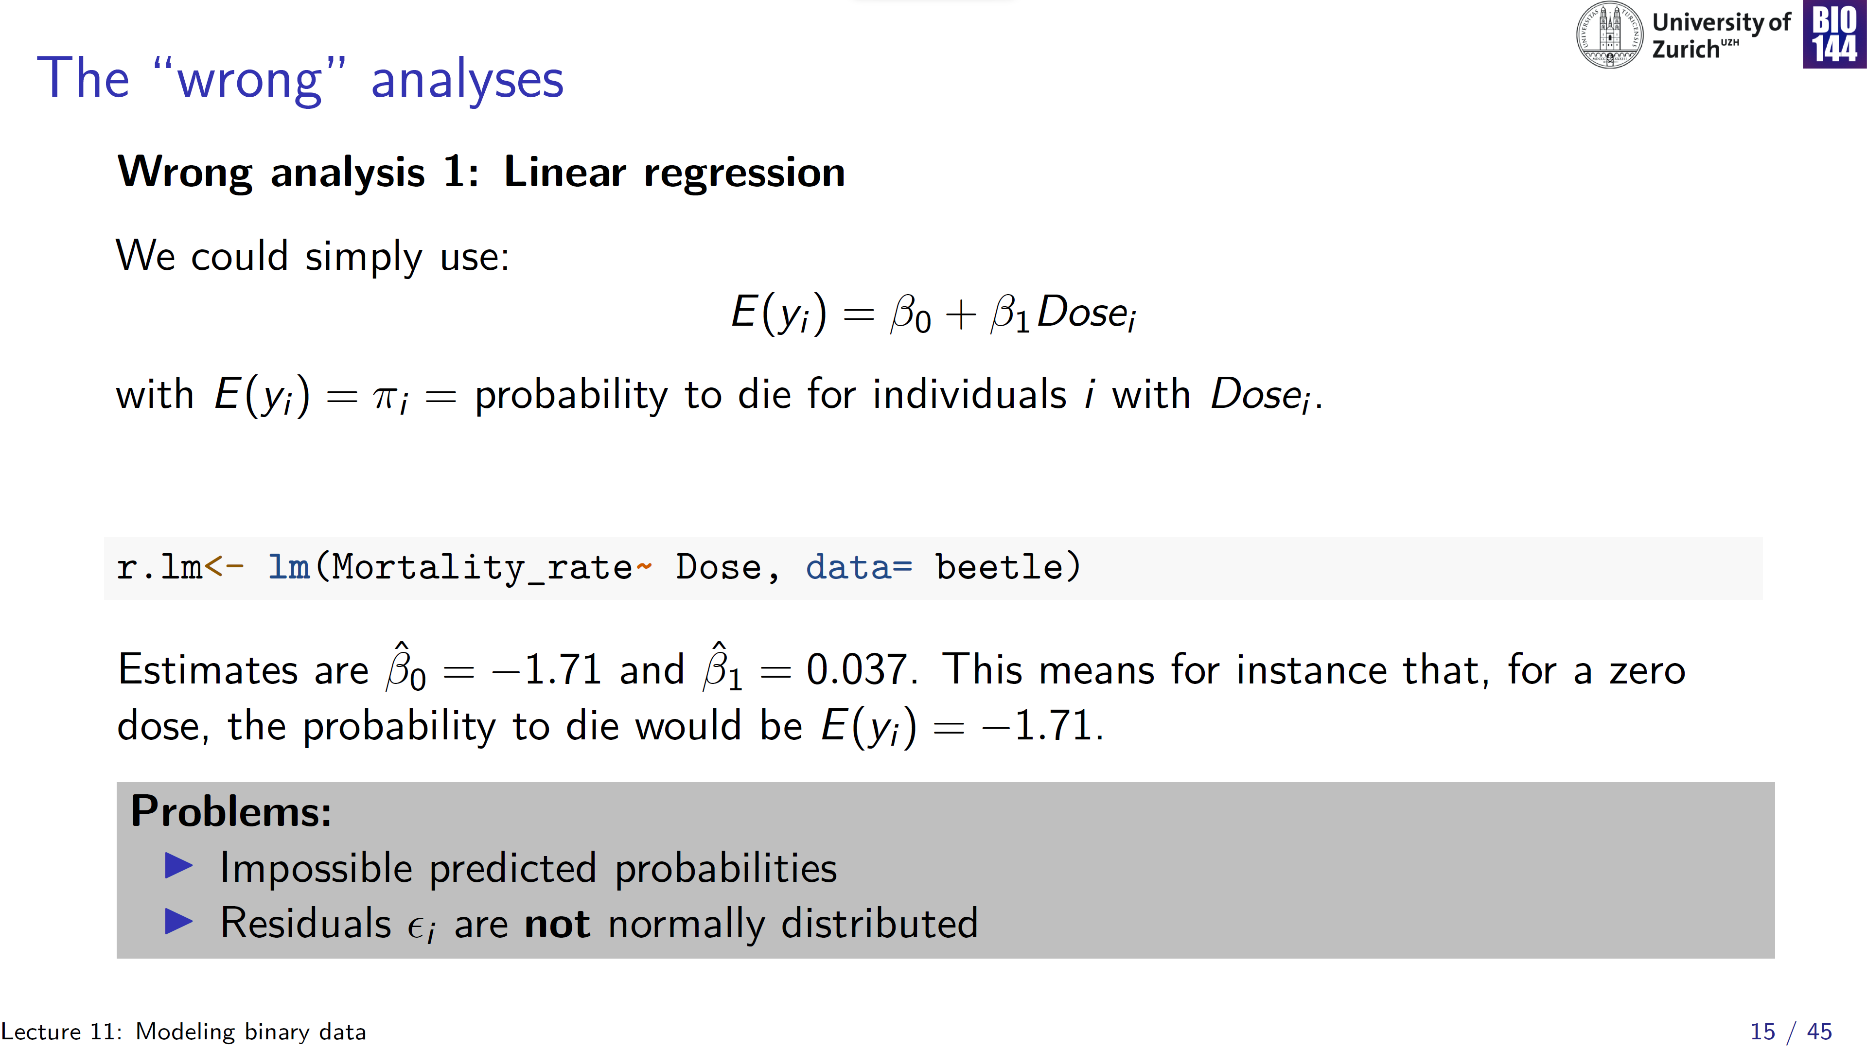
Notes:
Set the model to generate predictions on the original, probability scale

Slide 16
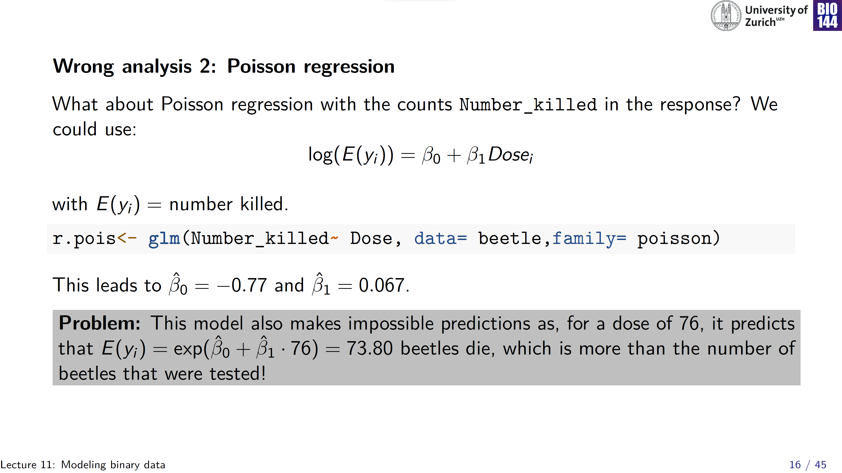
Notes:
Apply link-transform of Poisson: equate linear predictor to log-transformed predicted values
60 were tested for this dose
Model no longer makes predictions less than zero, but…

Slide 17
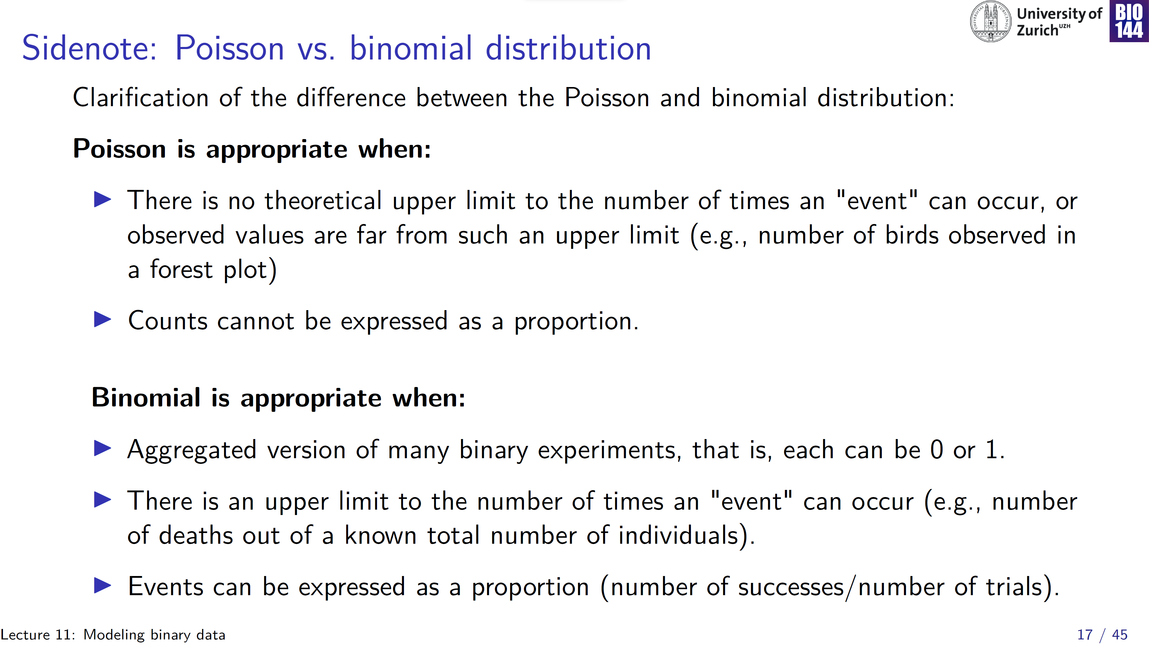

Slide 18
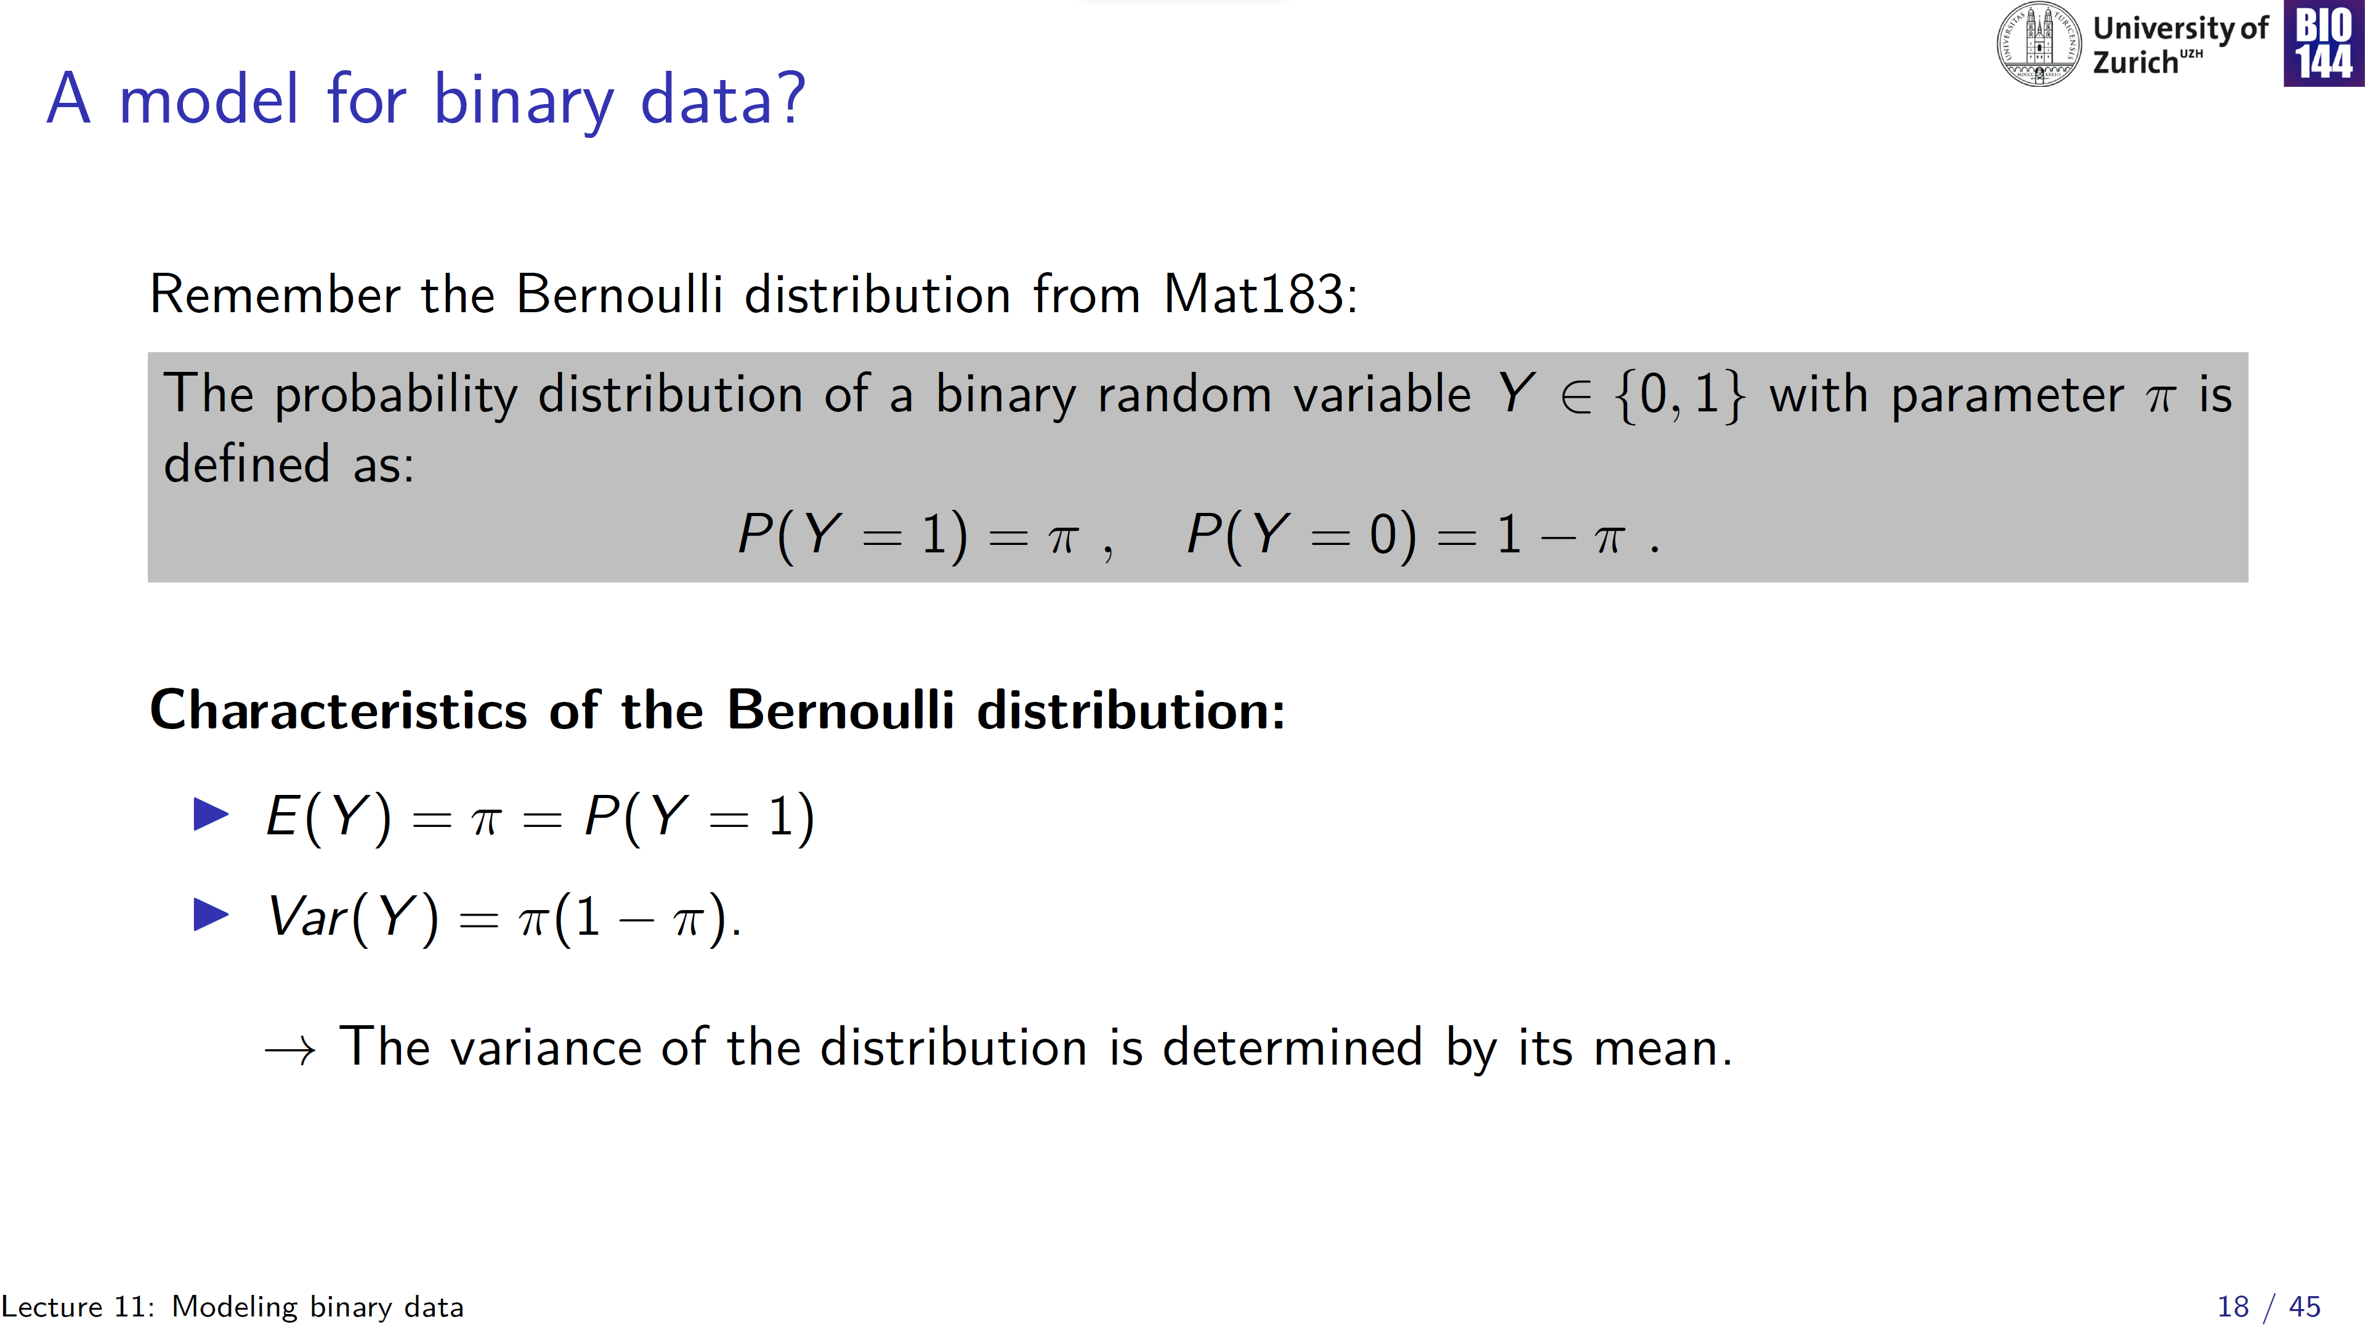
0.25
0.00
Var(y)
0 1
E(y)
Notes:
As we saw for the Poisson distribution, variance is a function of the mean, but where in Poisson variance increase with the mean, in the Binomial the relationship is different… uncertainty highest at intermediate mean values

Slide 19
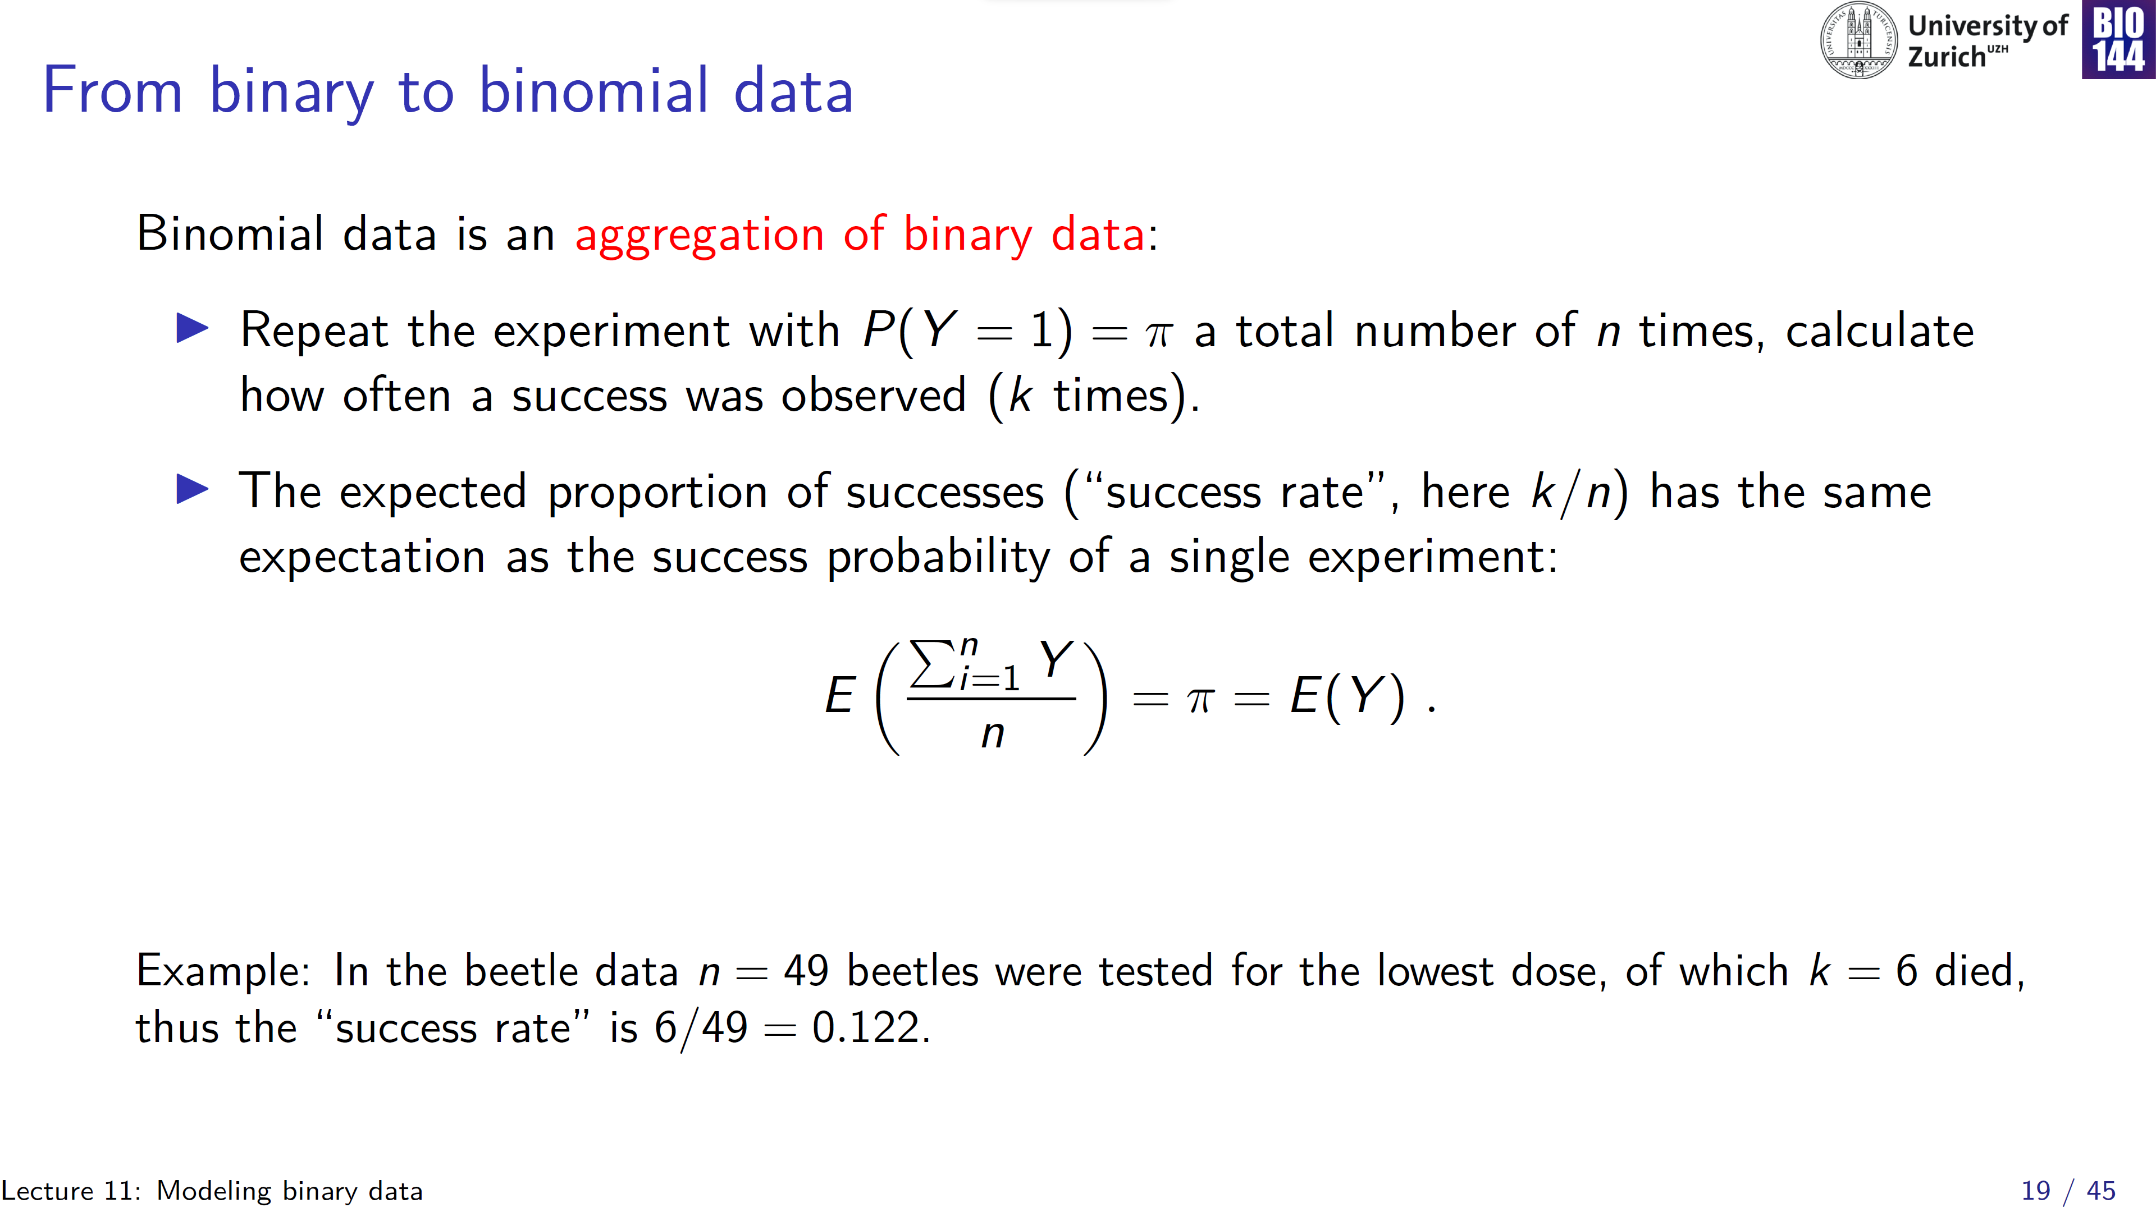
Notes:
Success probability is the same for each beetle tested at a given rate (so no already half-dead beetles in experiment)

Slide 20
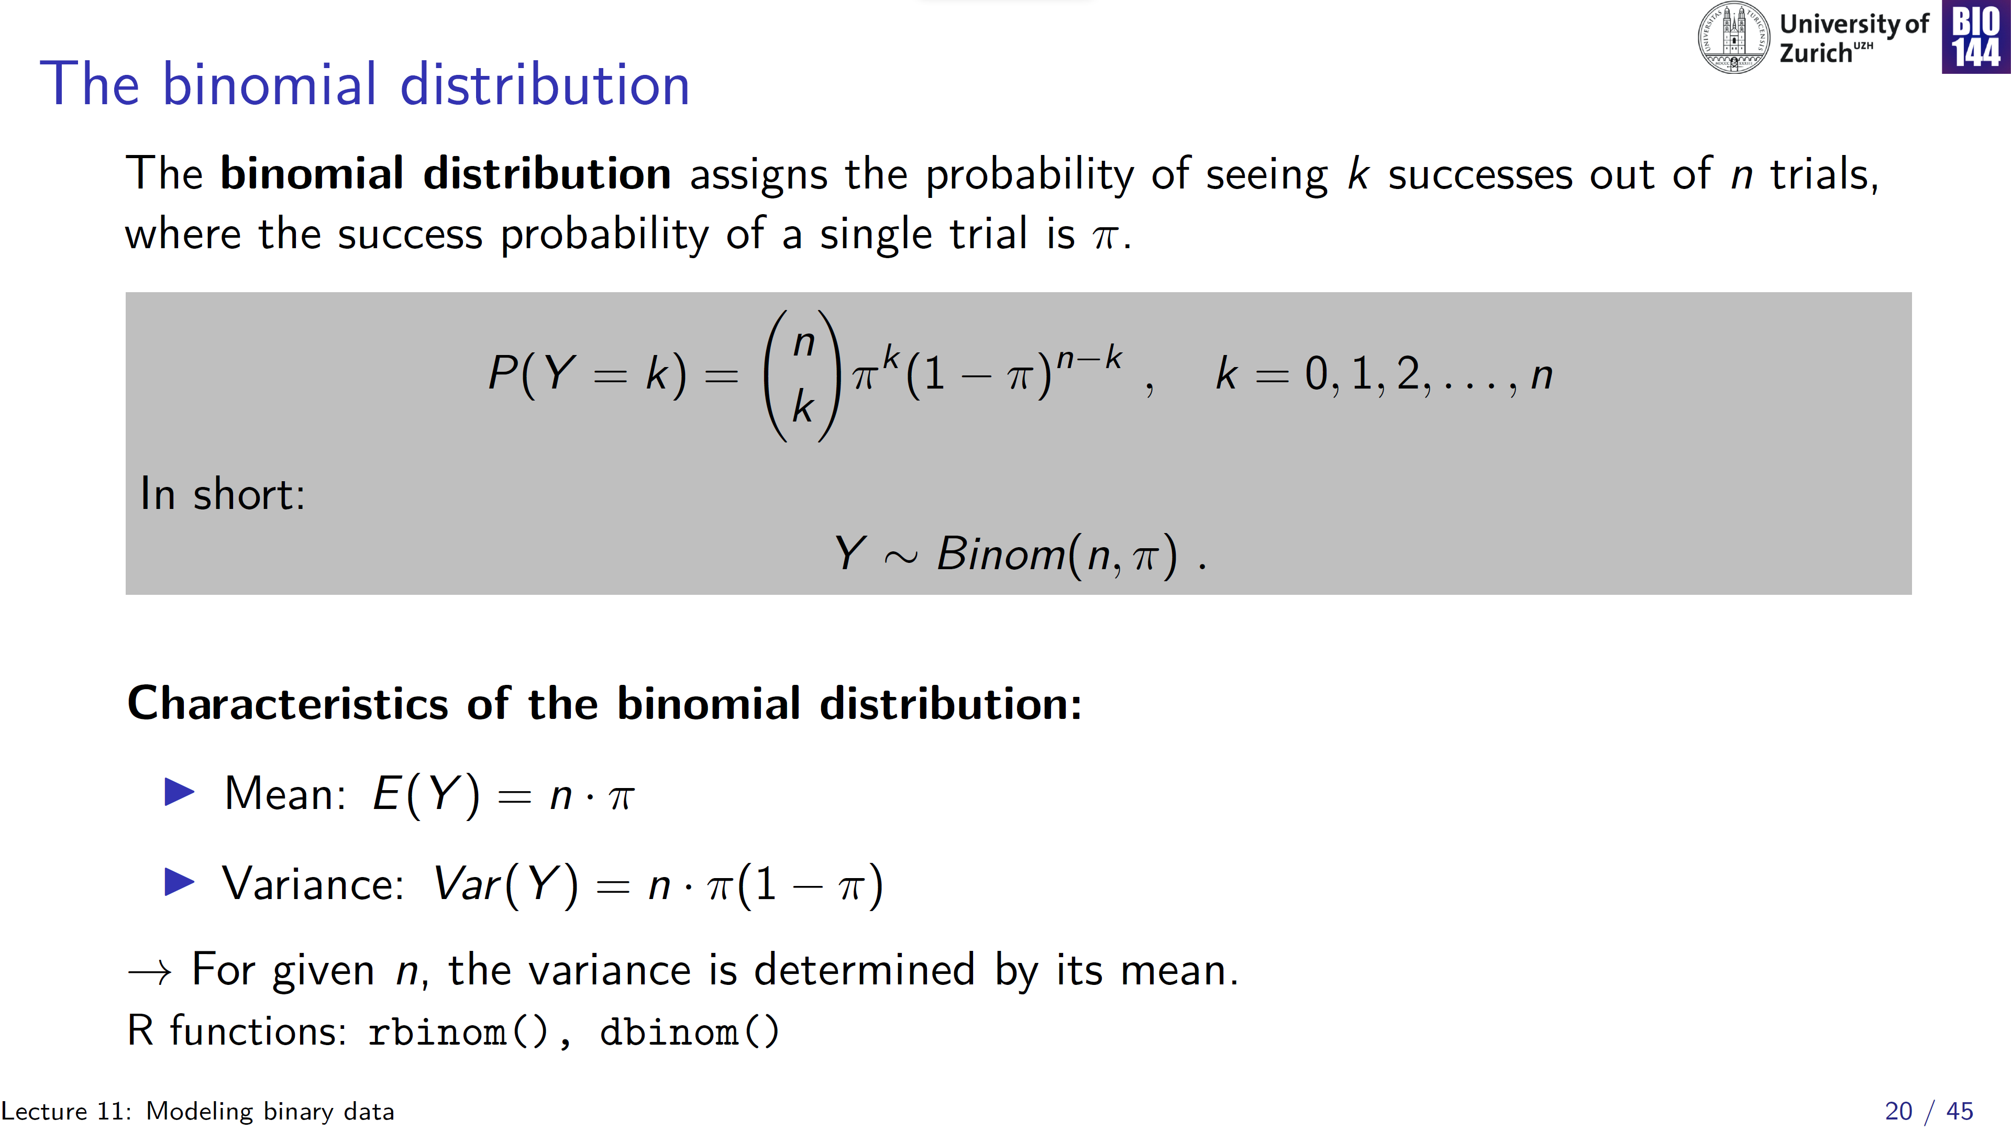
0.25 · n
0.00
Var(y)
0 n
E(y)
Notes:
Where n= 1 for binary data, each beetle either lives or dies with probability pi, and n>1 for binomial data, out of n beetles k died

Slide 21
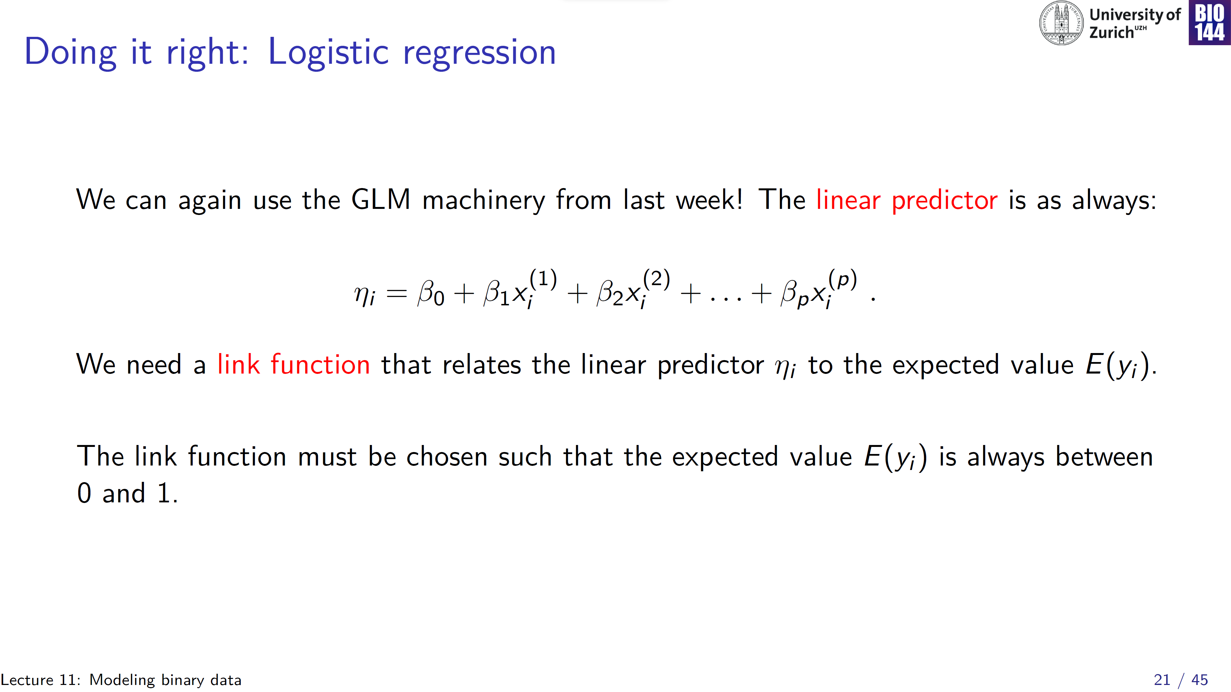
Notes:
No error term because in a GLM eta is equated to model predictions, rather than values of the outcome variable directly, therefore no errors yet!

Slide 22
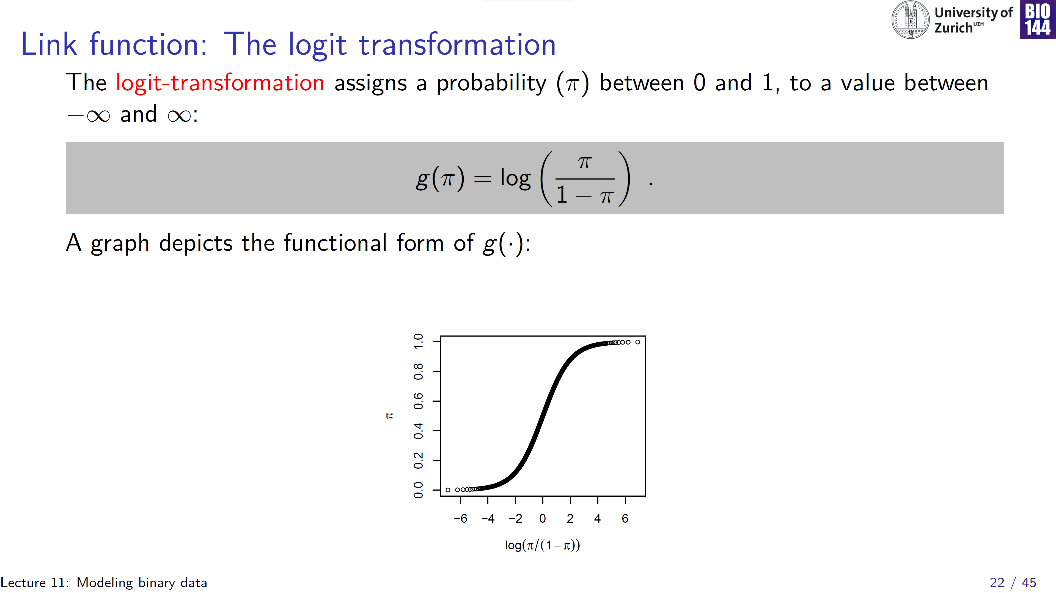
odds
log odds transform, or “logit”

Slide 23
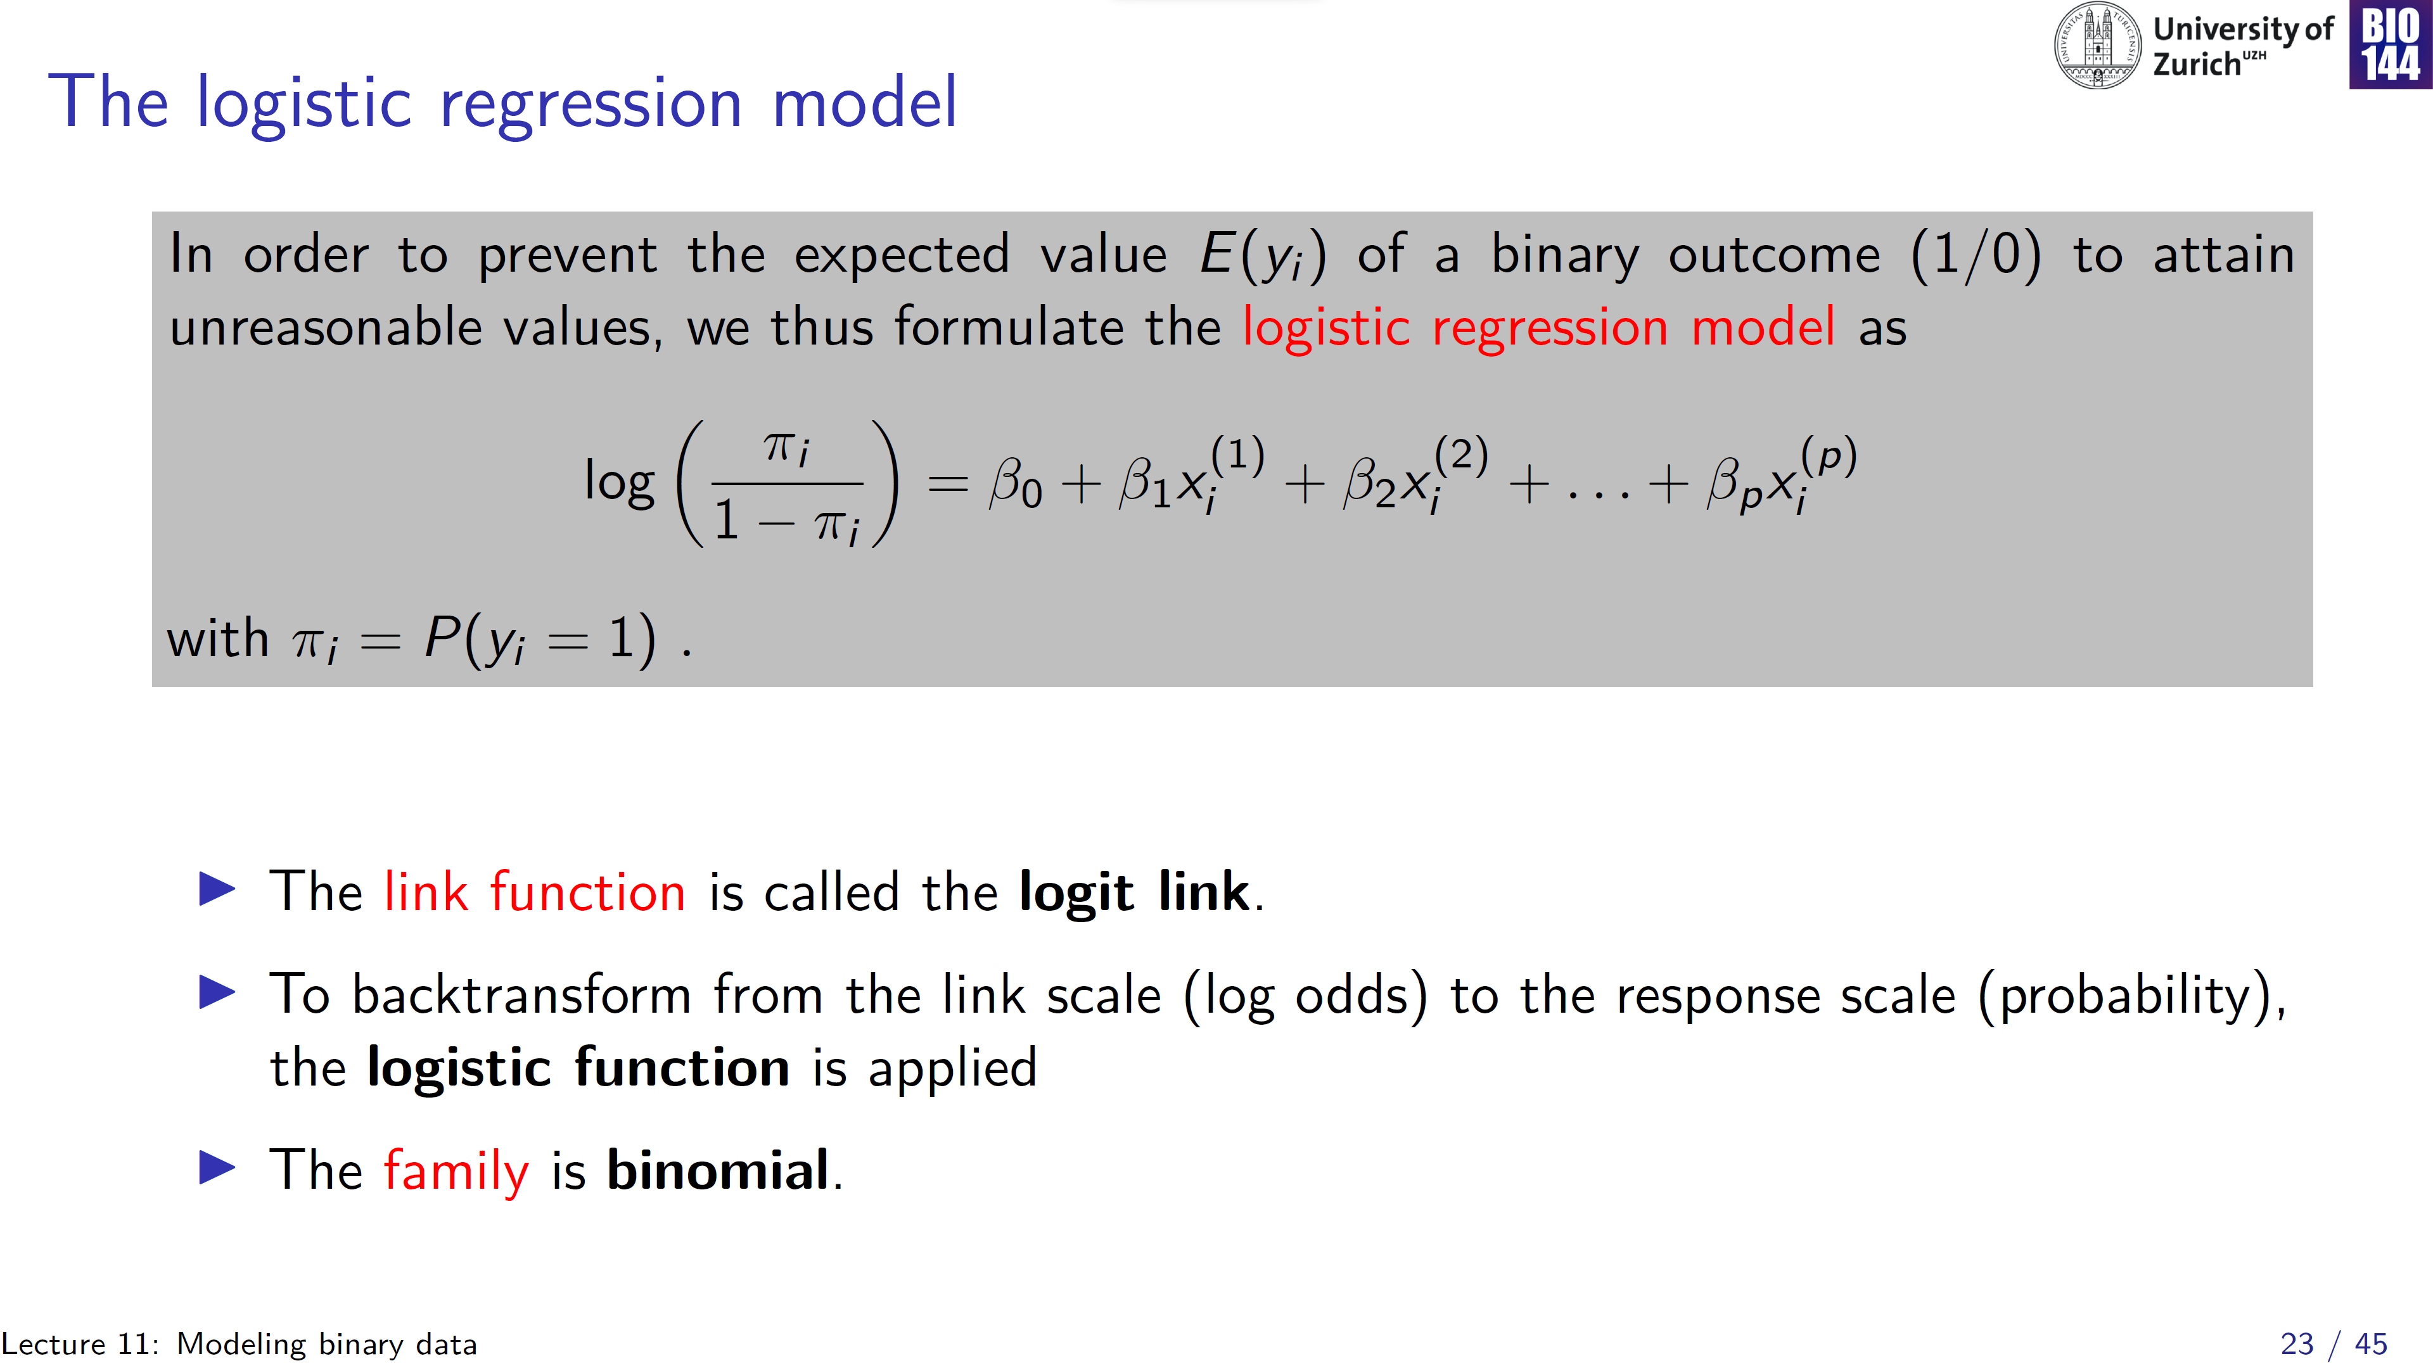

Slide 24
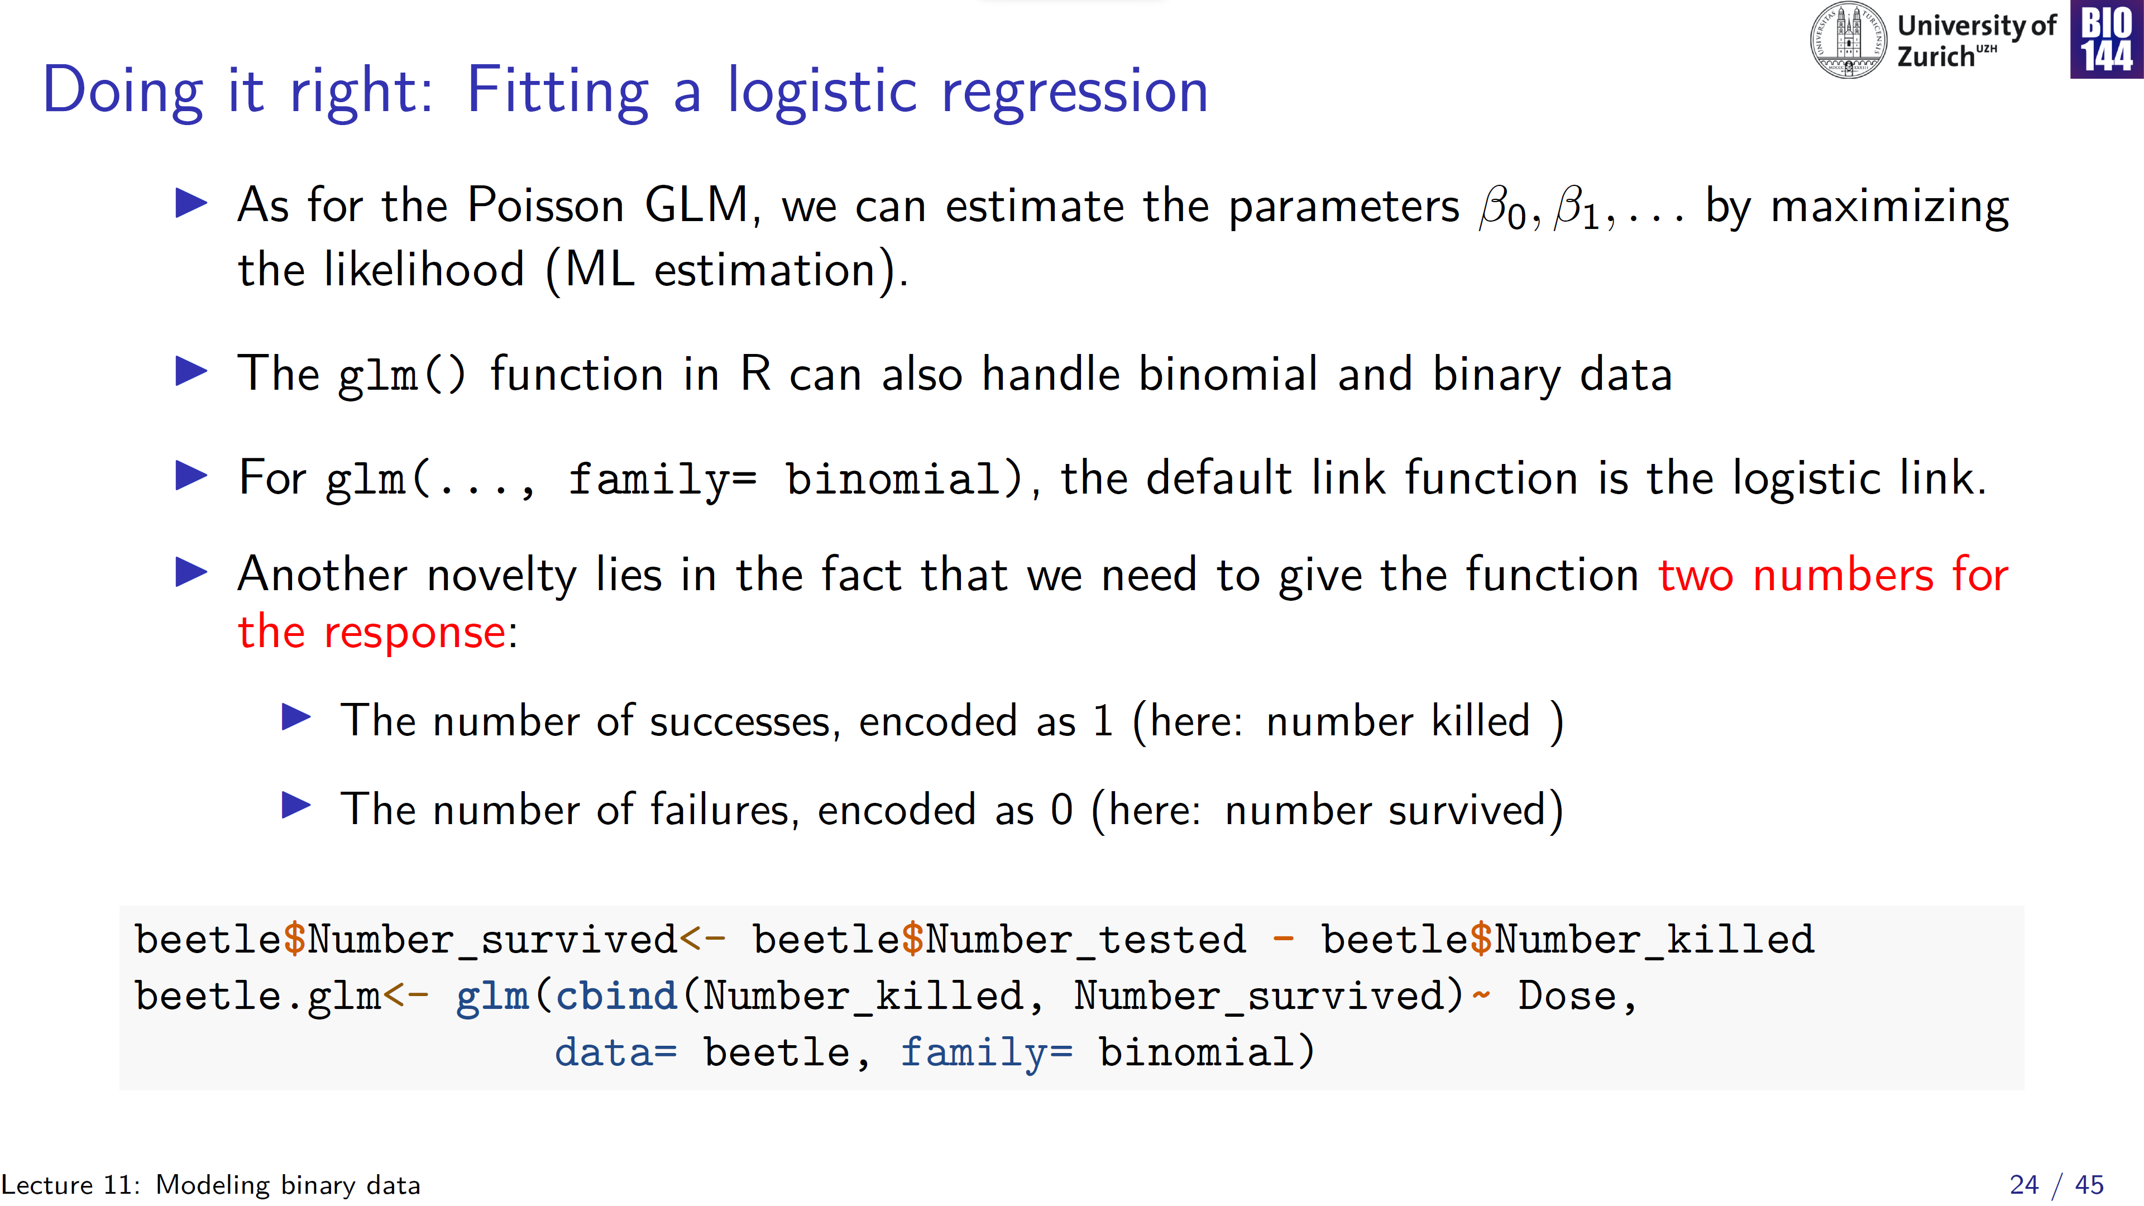

Slide 25
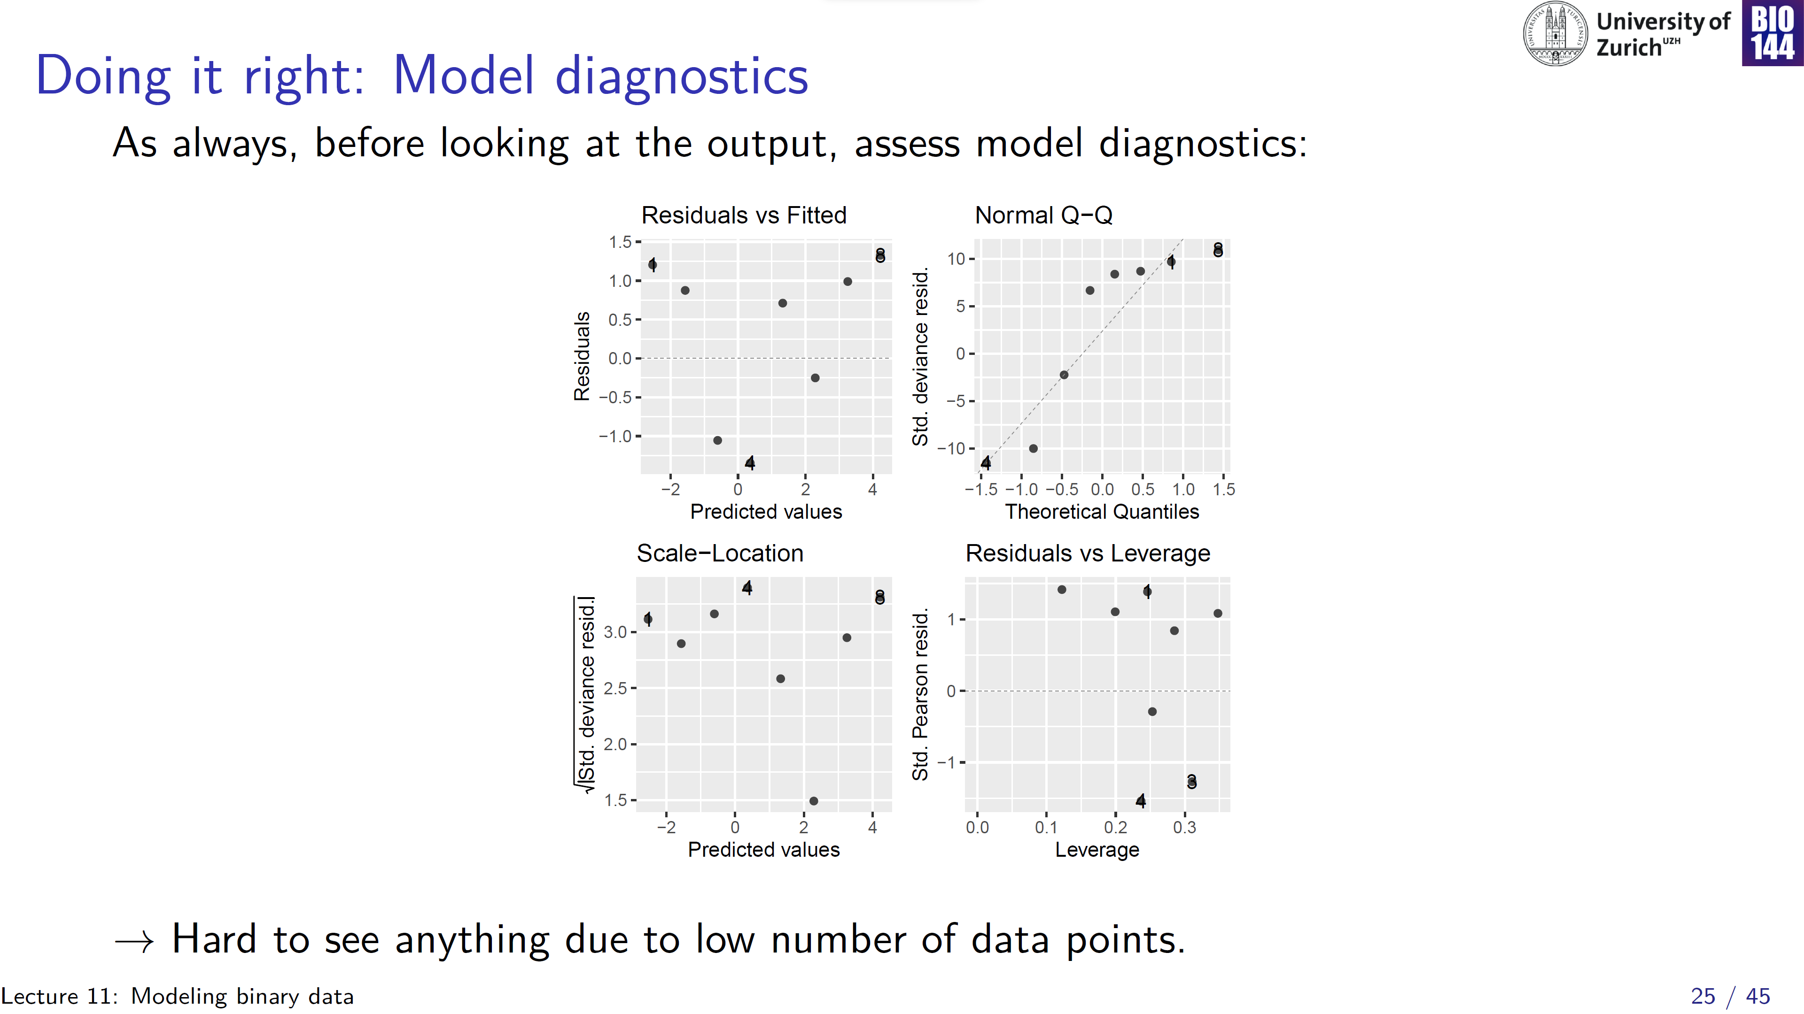
Notes:
Point out different residuals on the y-axis

Slide 26
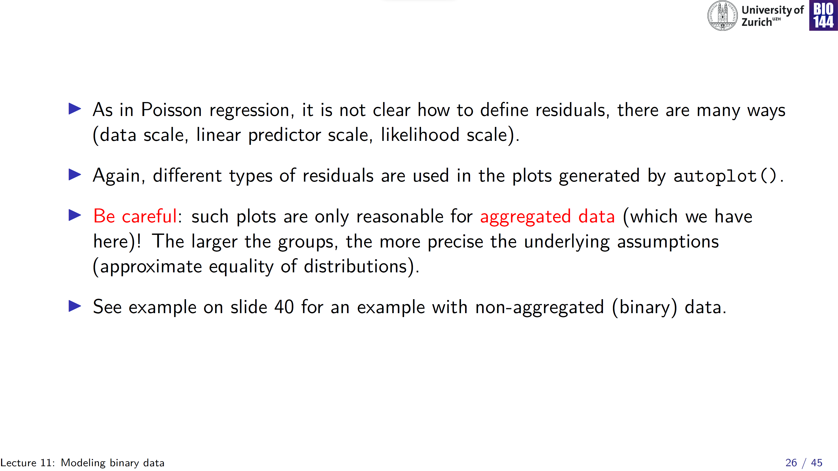

Slide 27
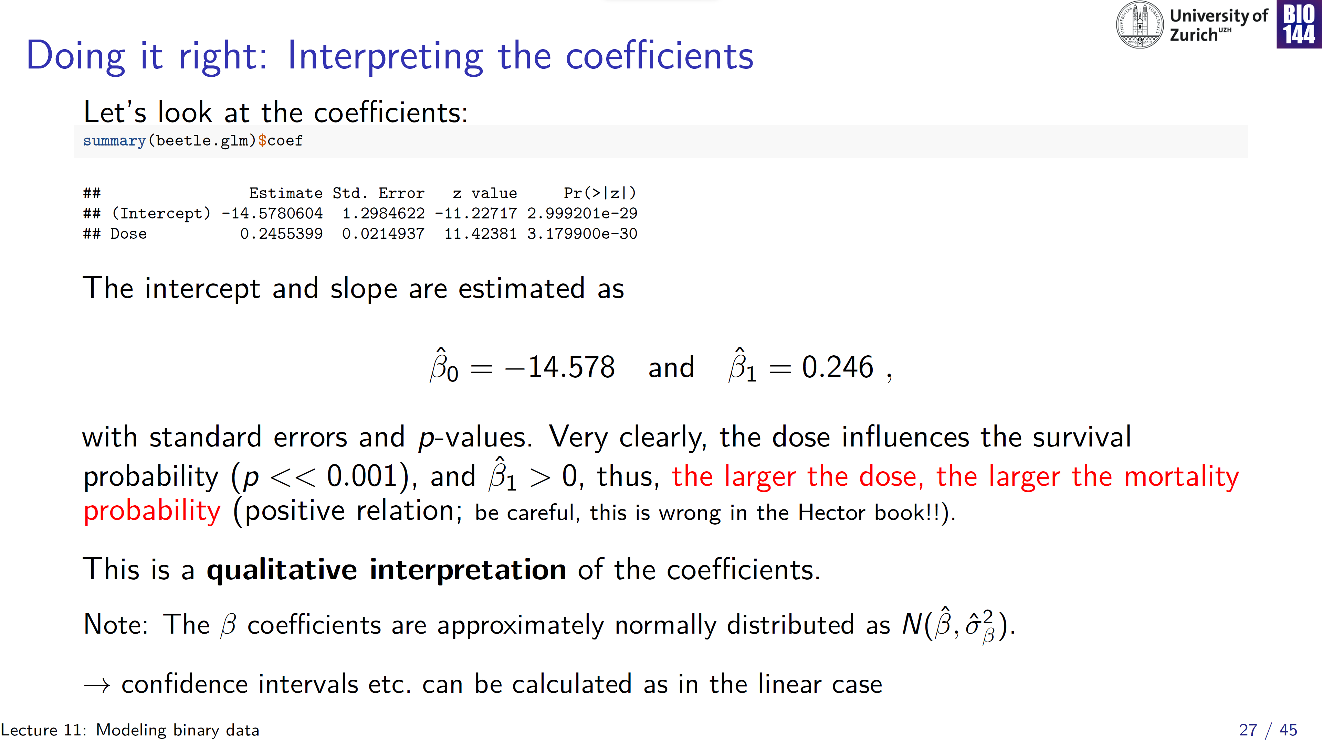
Notes:
Betas are at the log odds scale… hard to interpret

Slide 28
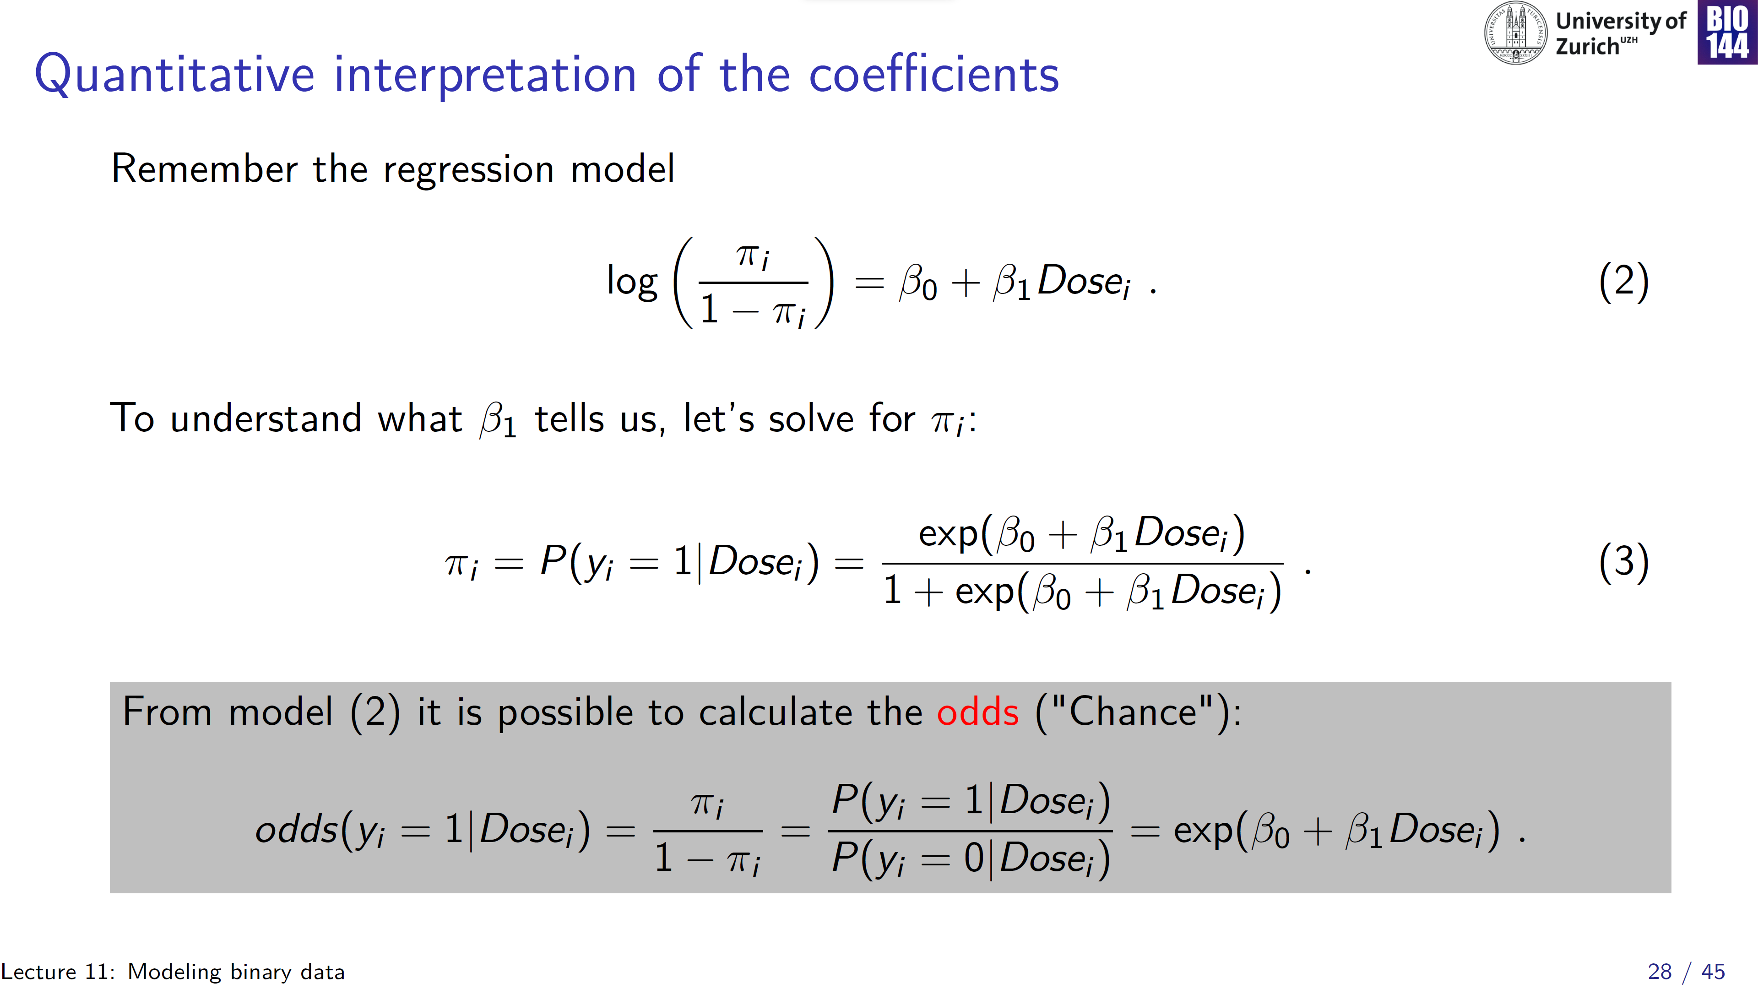
Notes:
Need to exponentiate both sides, and then multiple by 1 - pi

Slide 29
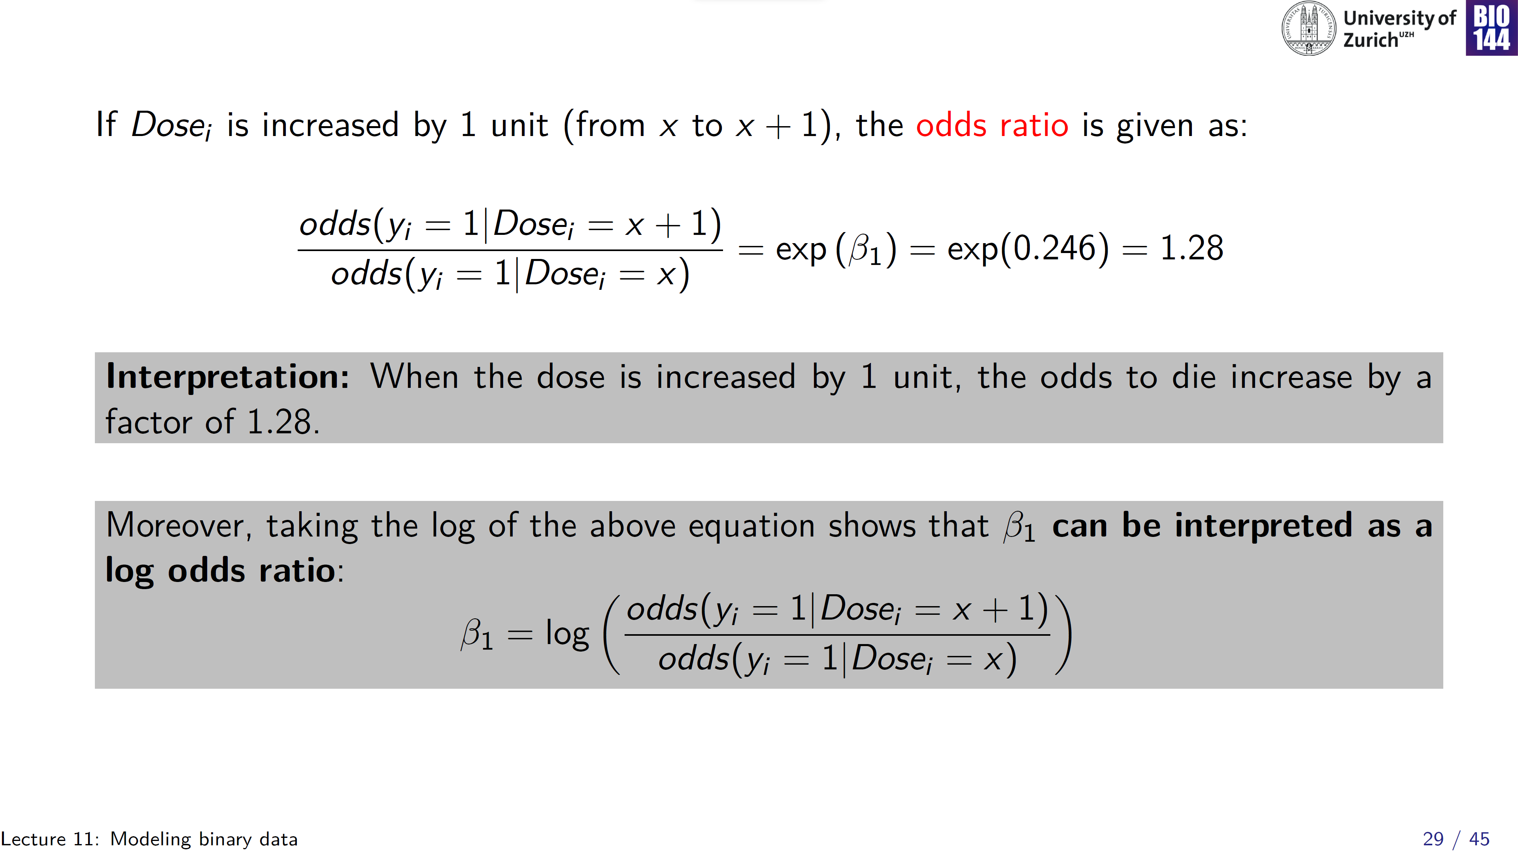

Slide 30
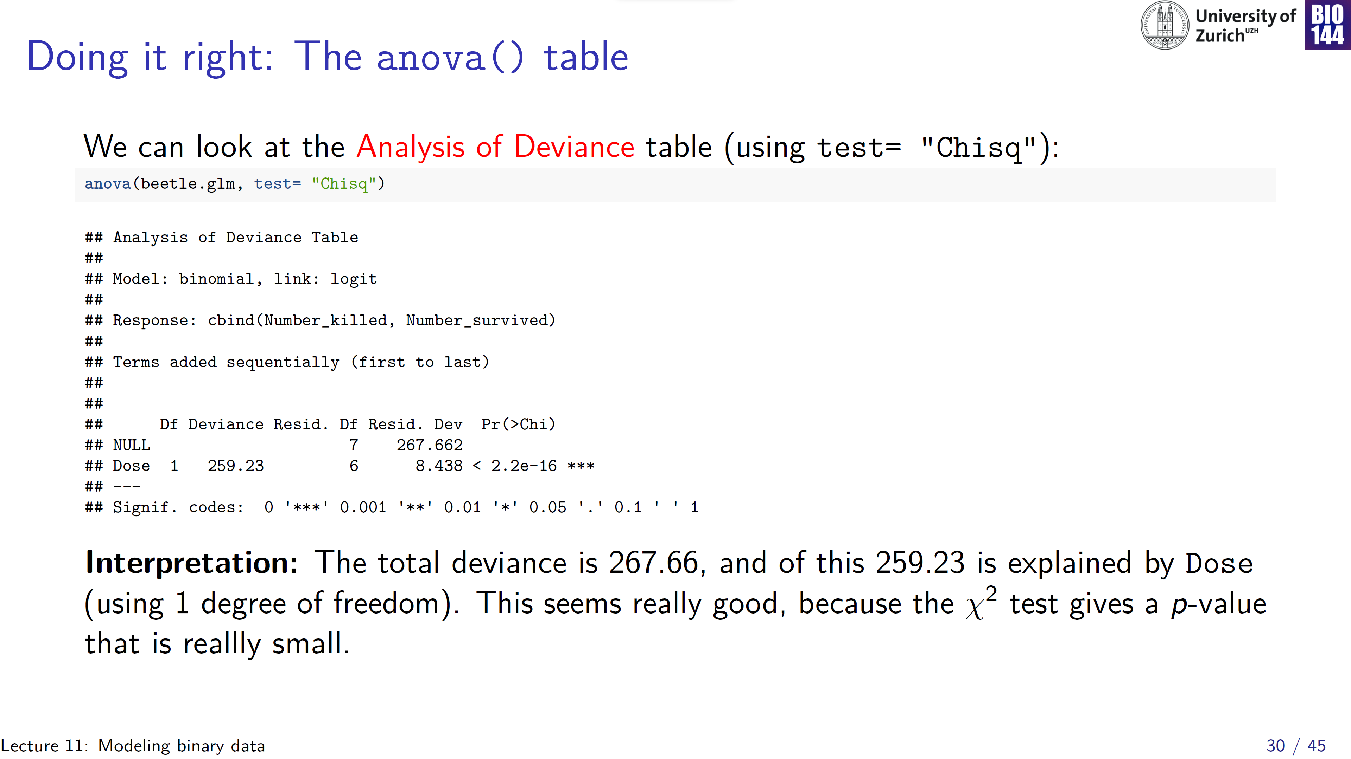
“SS _{total}”
“SS _{model}”

Slide 31
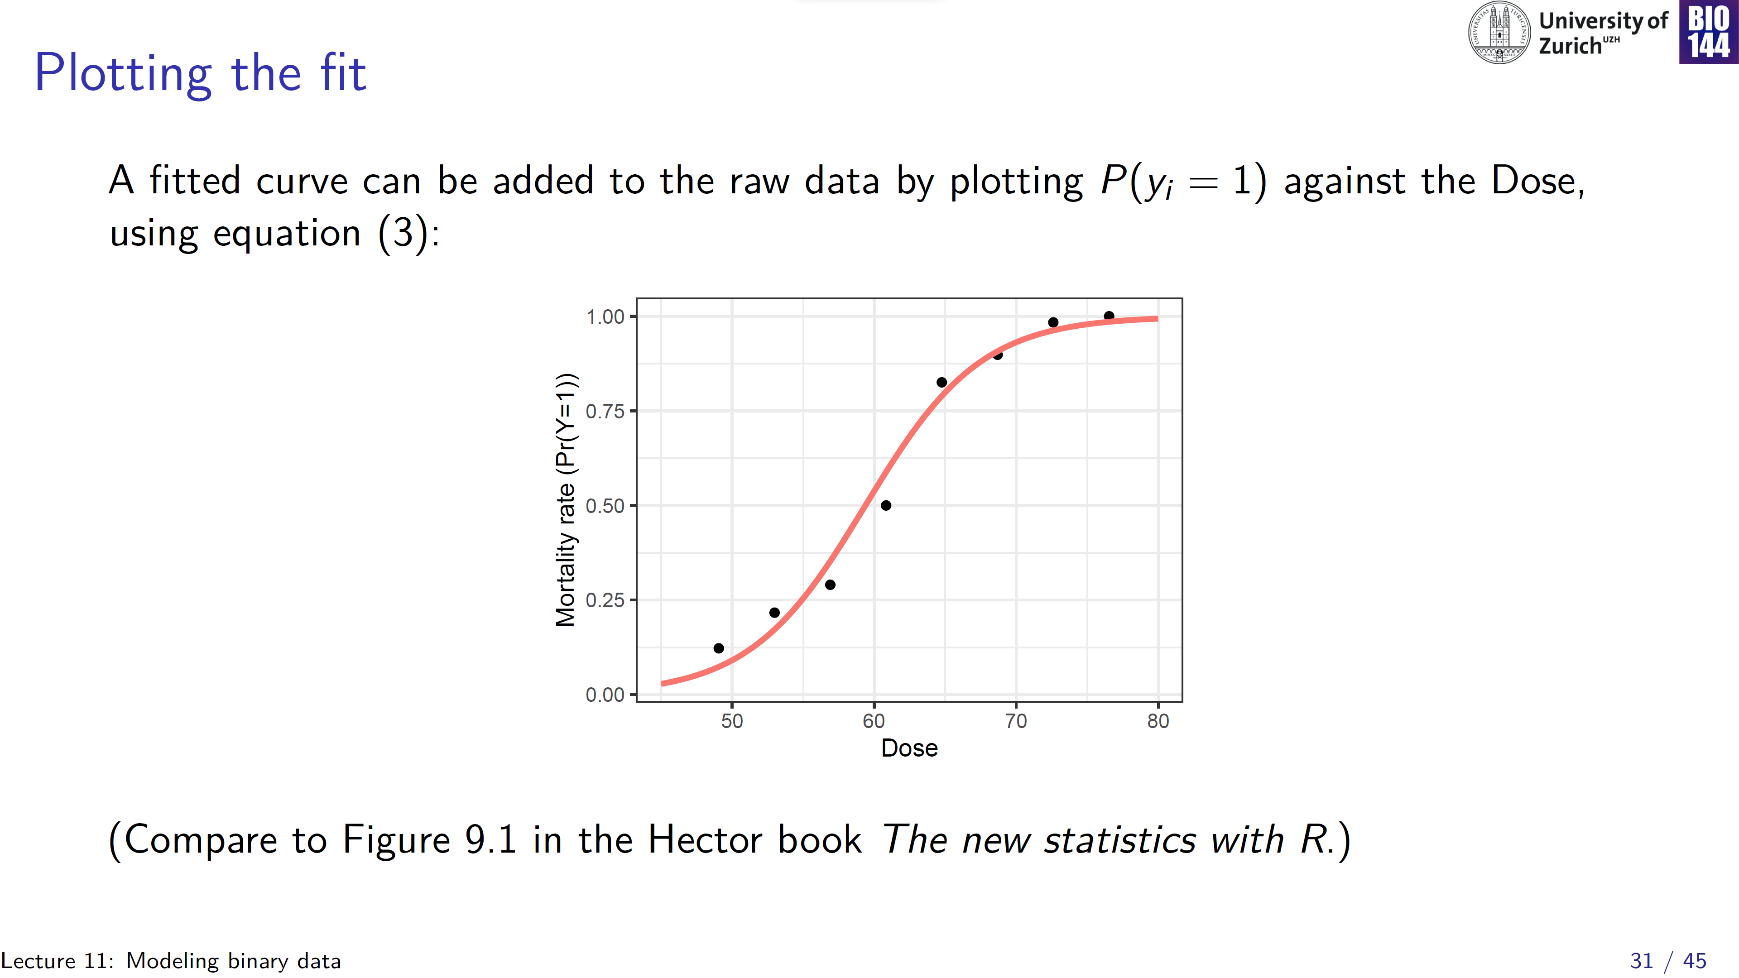
Notes:
Point out how model predictions are restricted to 0, 1

Slide 32
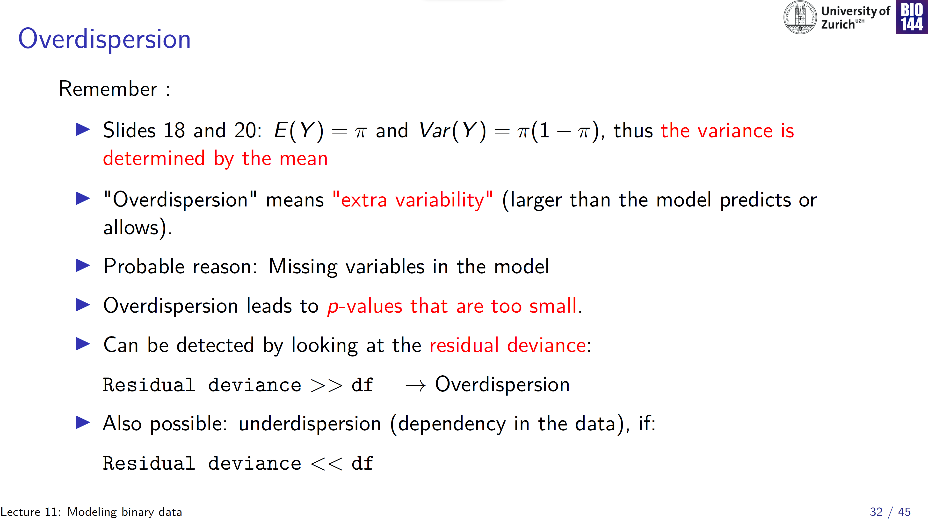
Inflated risk of Type I error
Inflated risk of Type II error

Slide 33
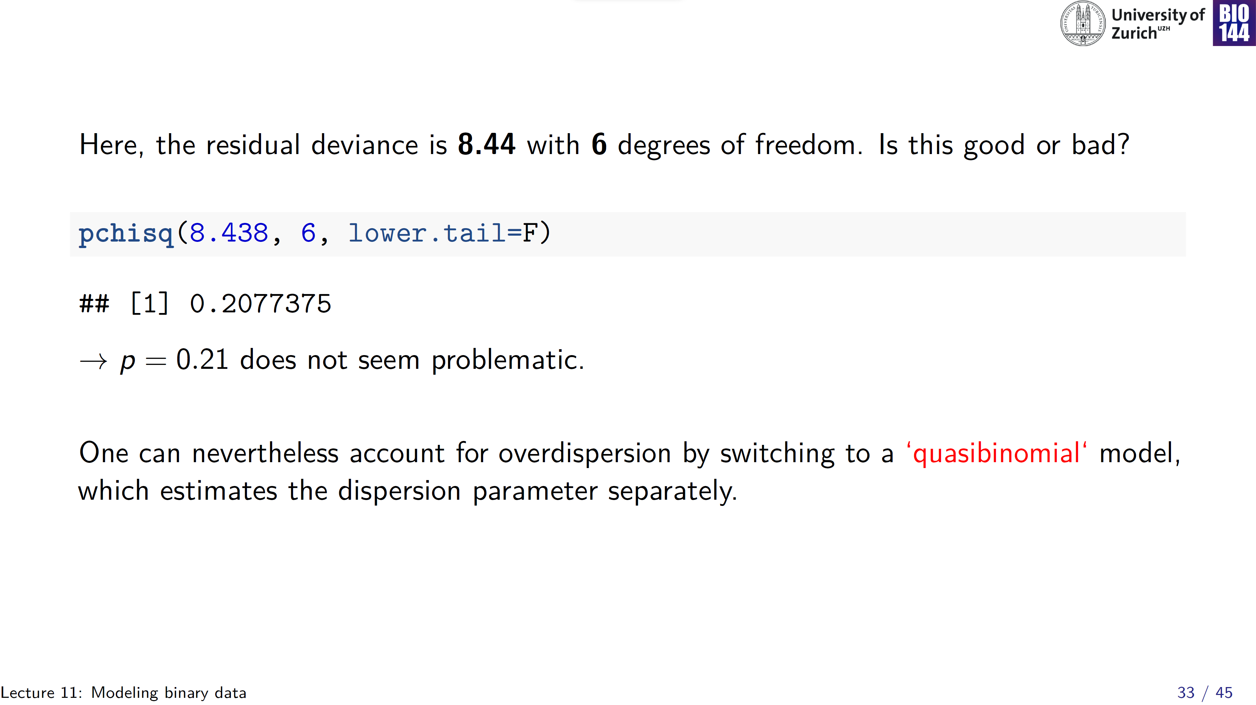

Slide 34
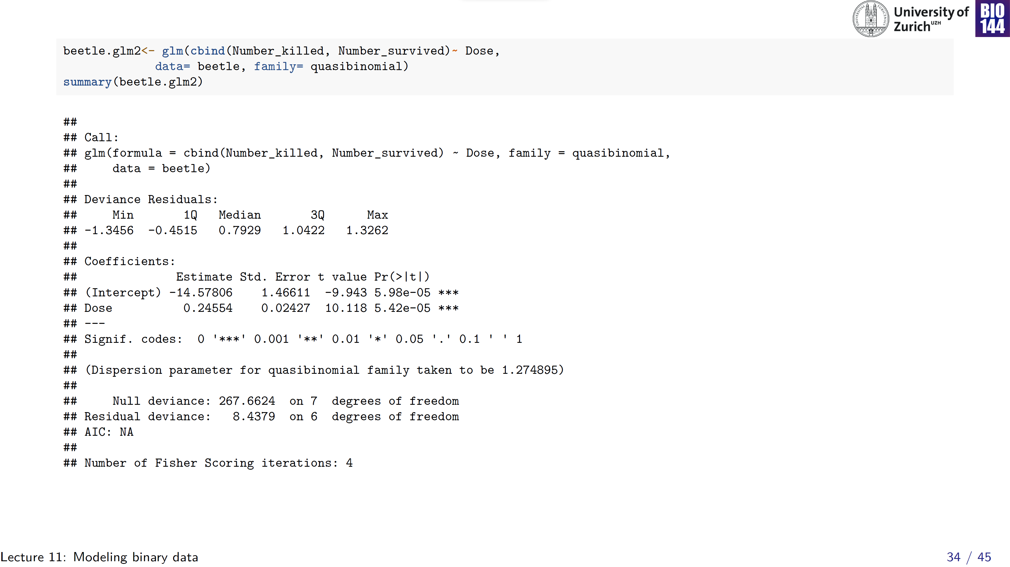
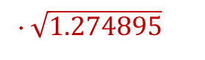
Same
· $\sqrt{1.274895}$

Slide 35
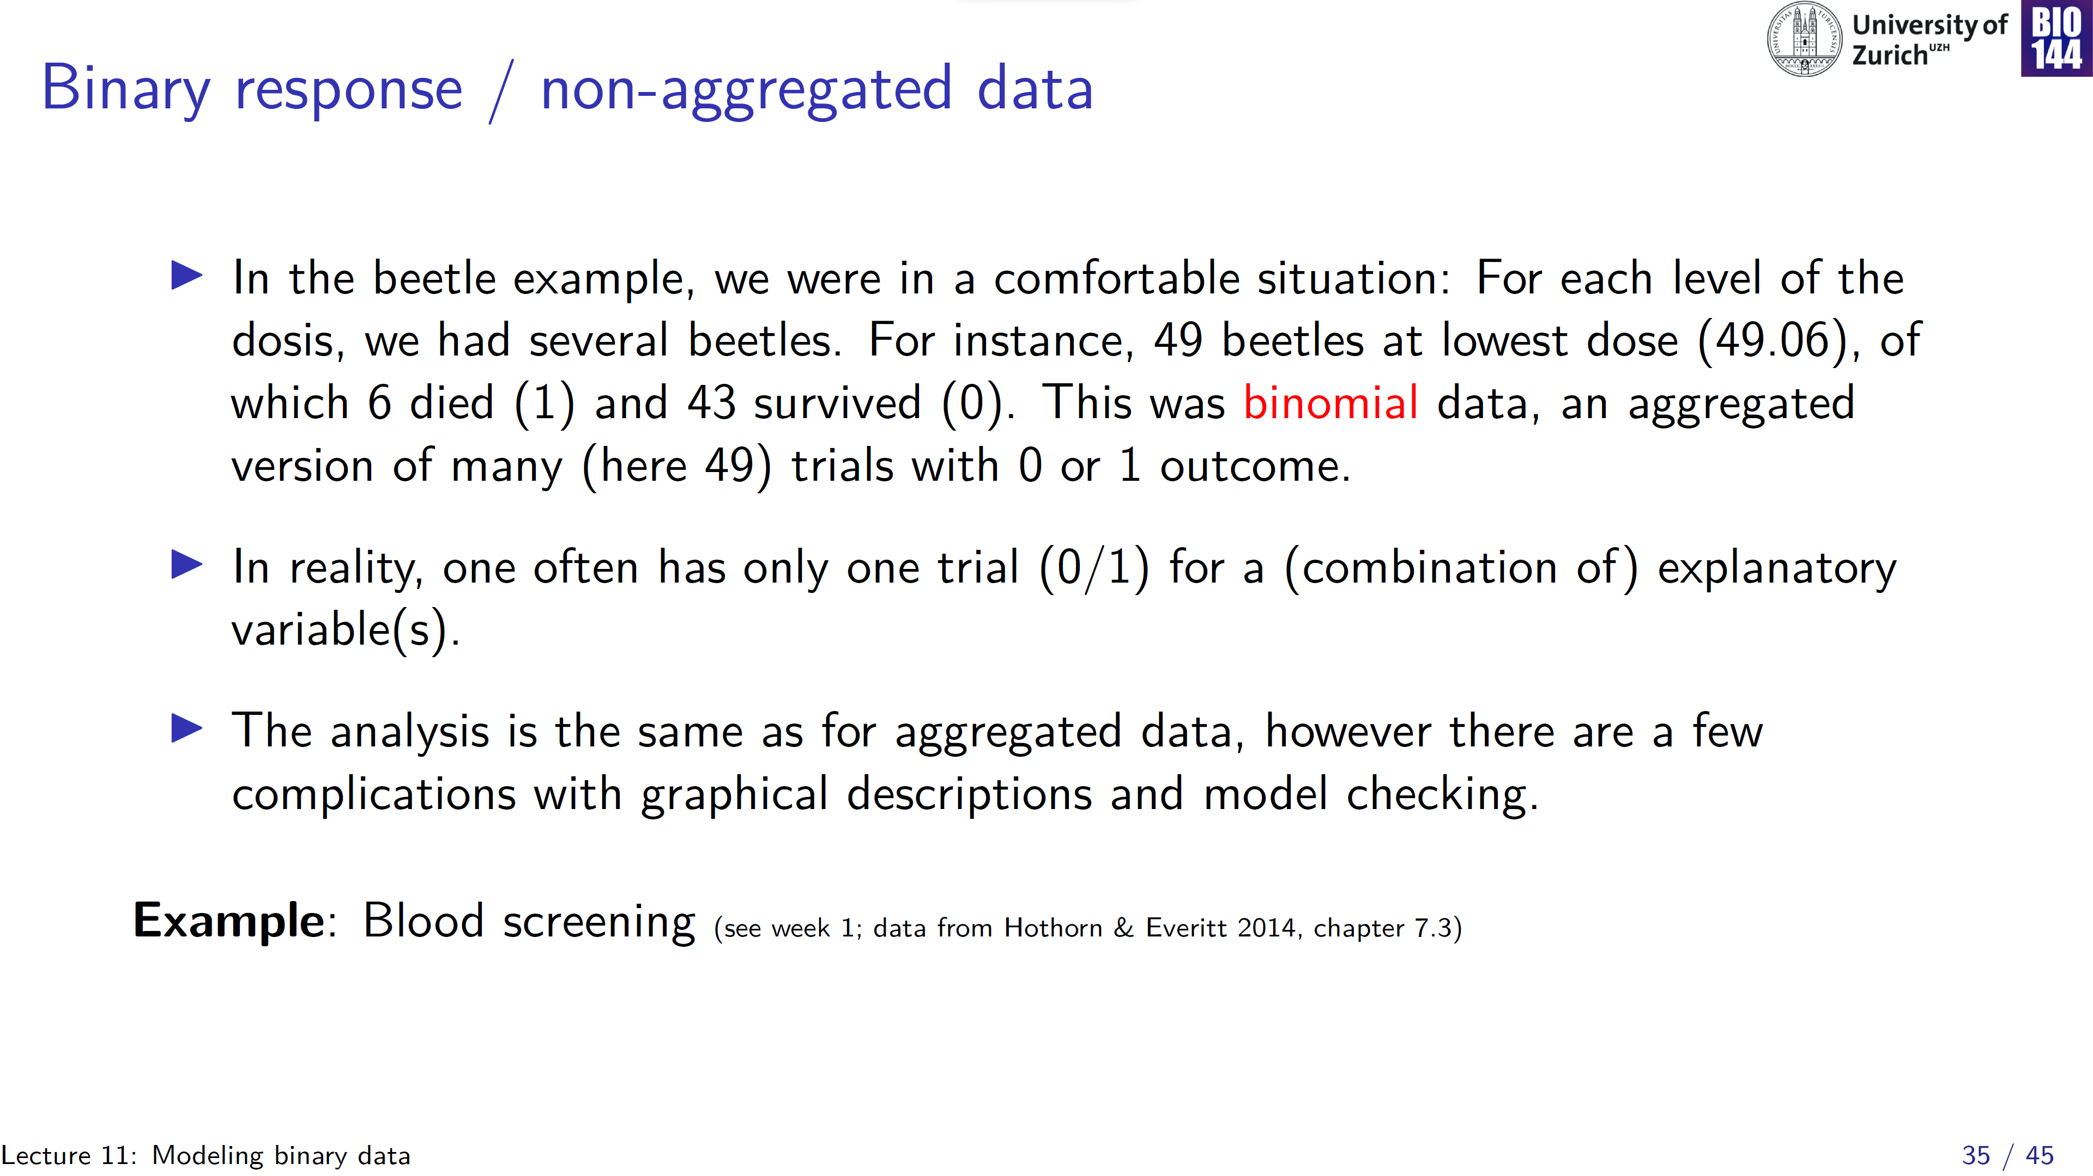

Slide 36
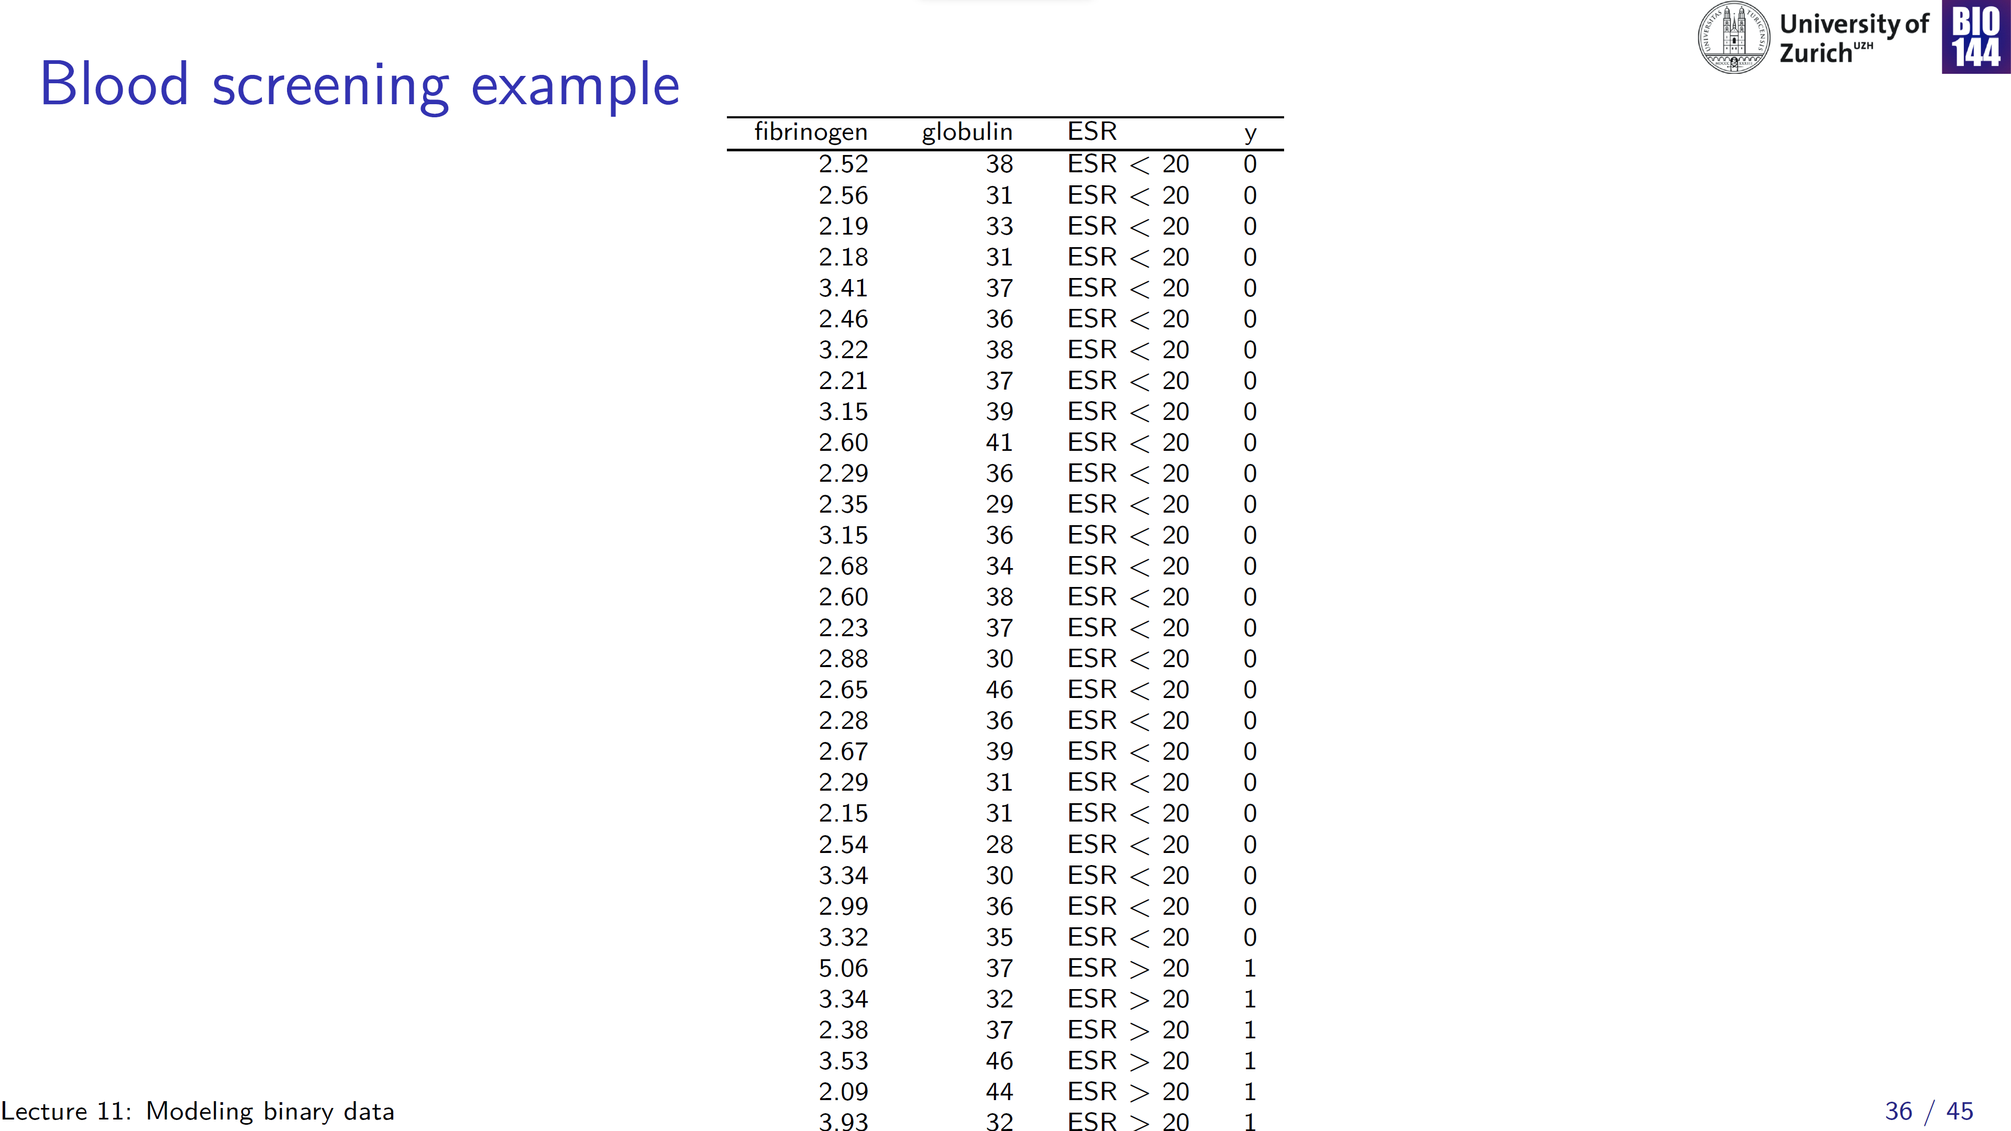
2 continuous predictors
binary outcome (recoded to 0/1)
Notes:
ESR= Erythrocyte Sedimentation Rate

Slide 37
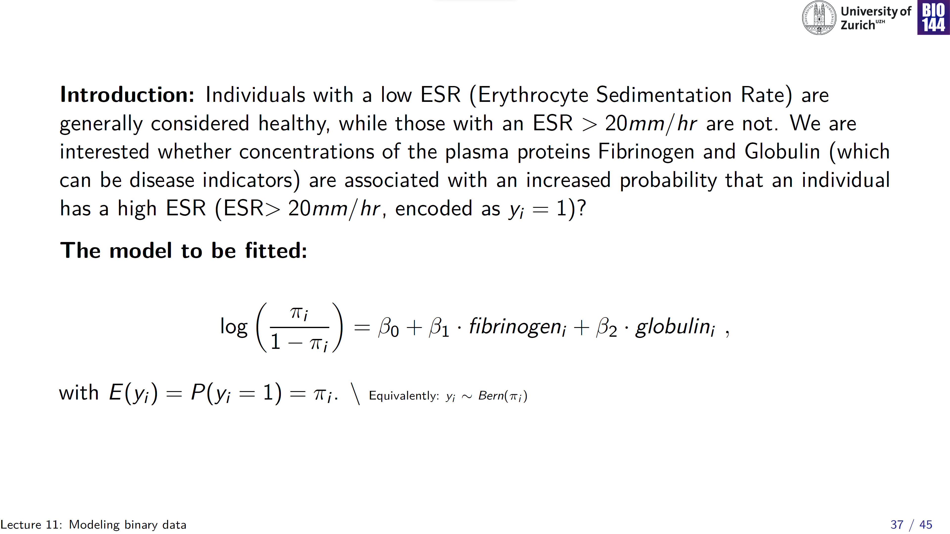

Slide 38
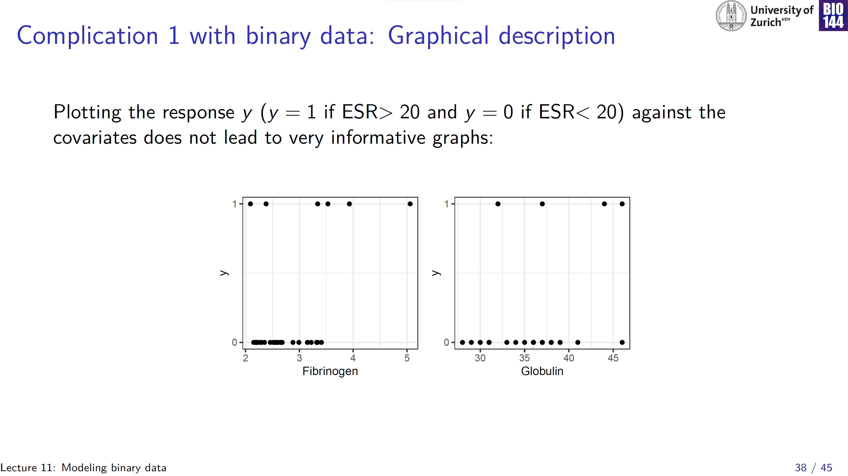
Notes:
Can do a bit better than this, but still, hard to read these figures

Slide 39
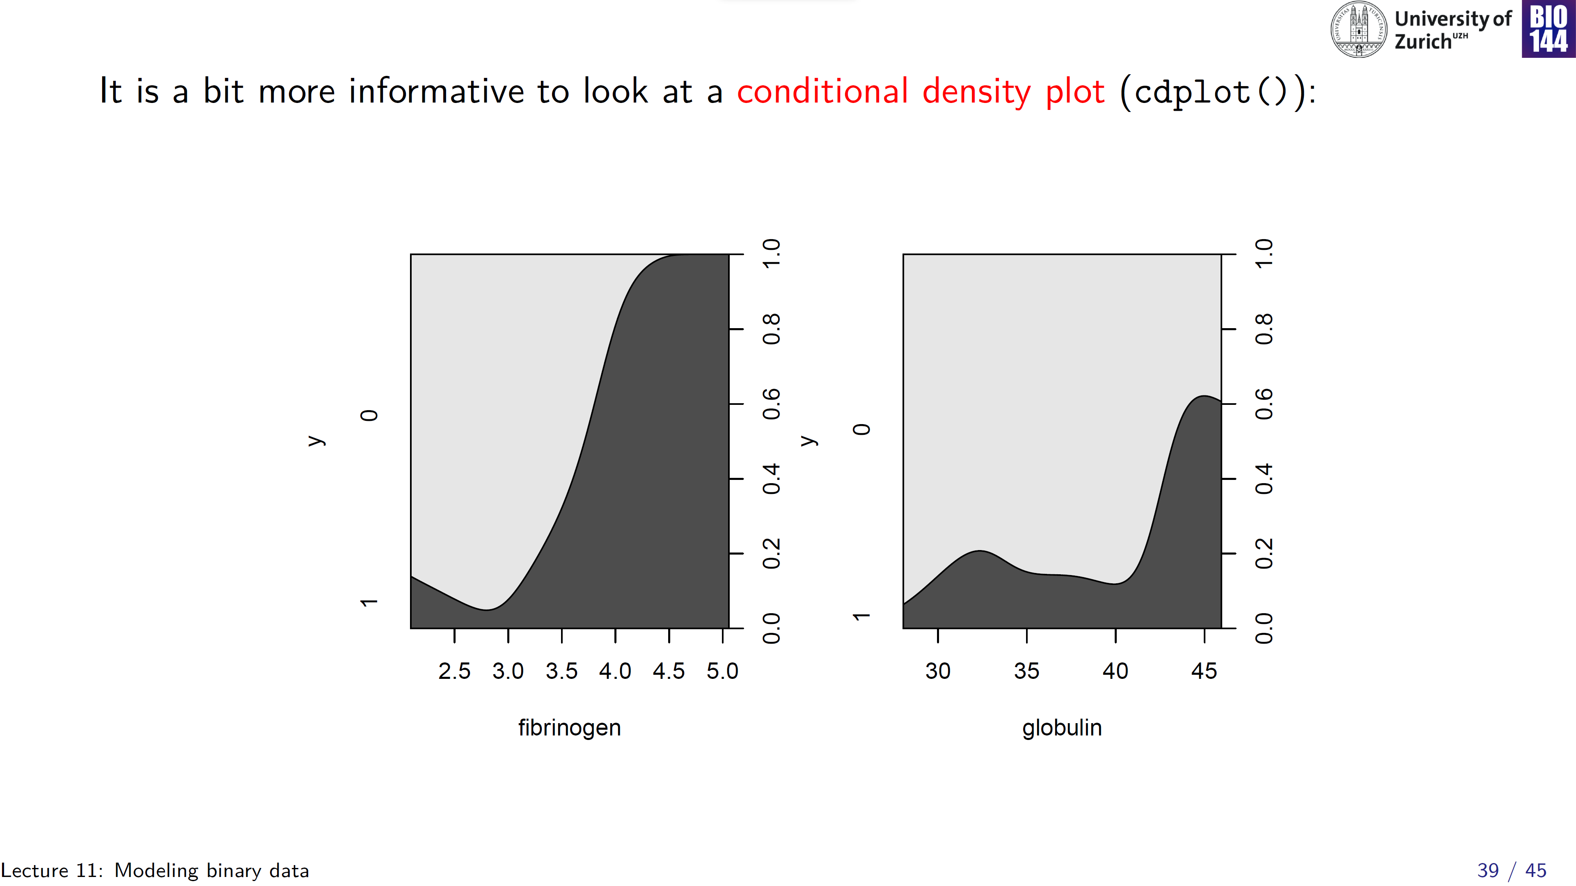

Slide 40
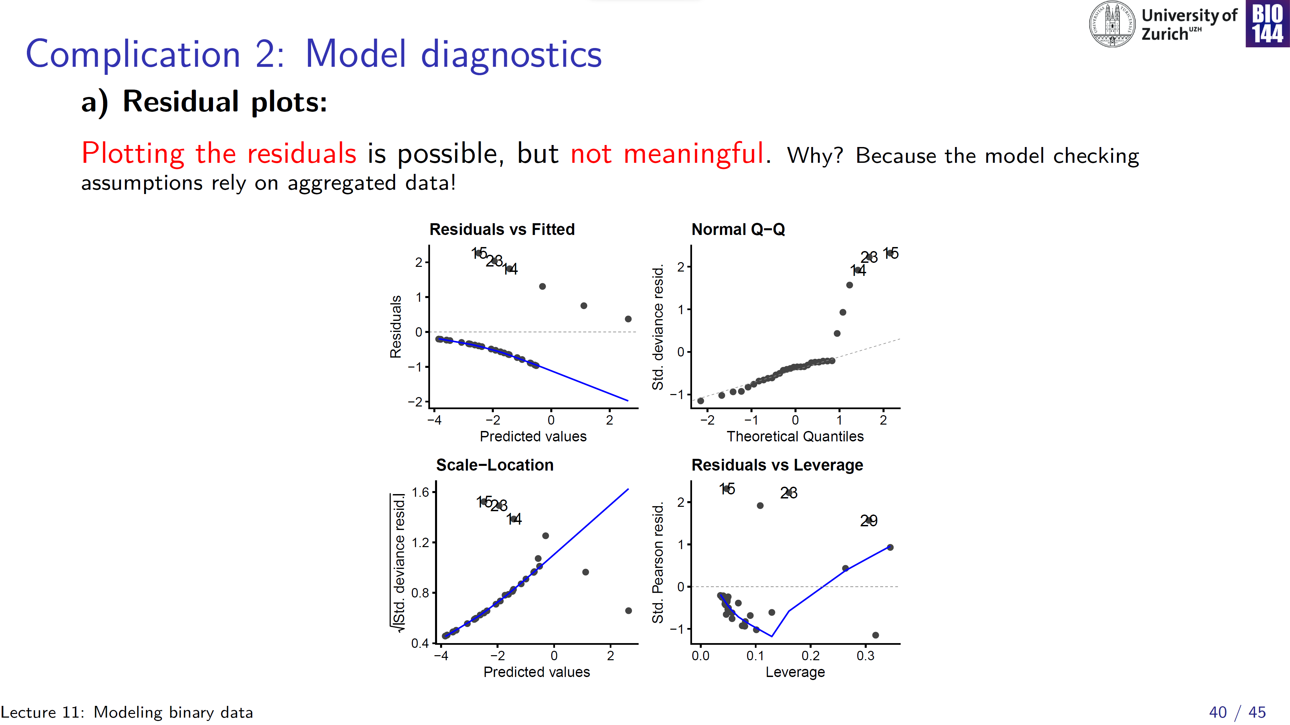

Slide 41
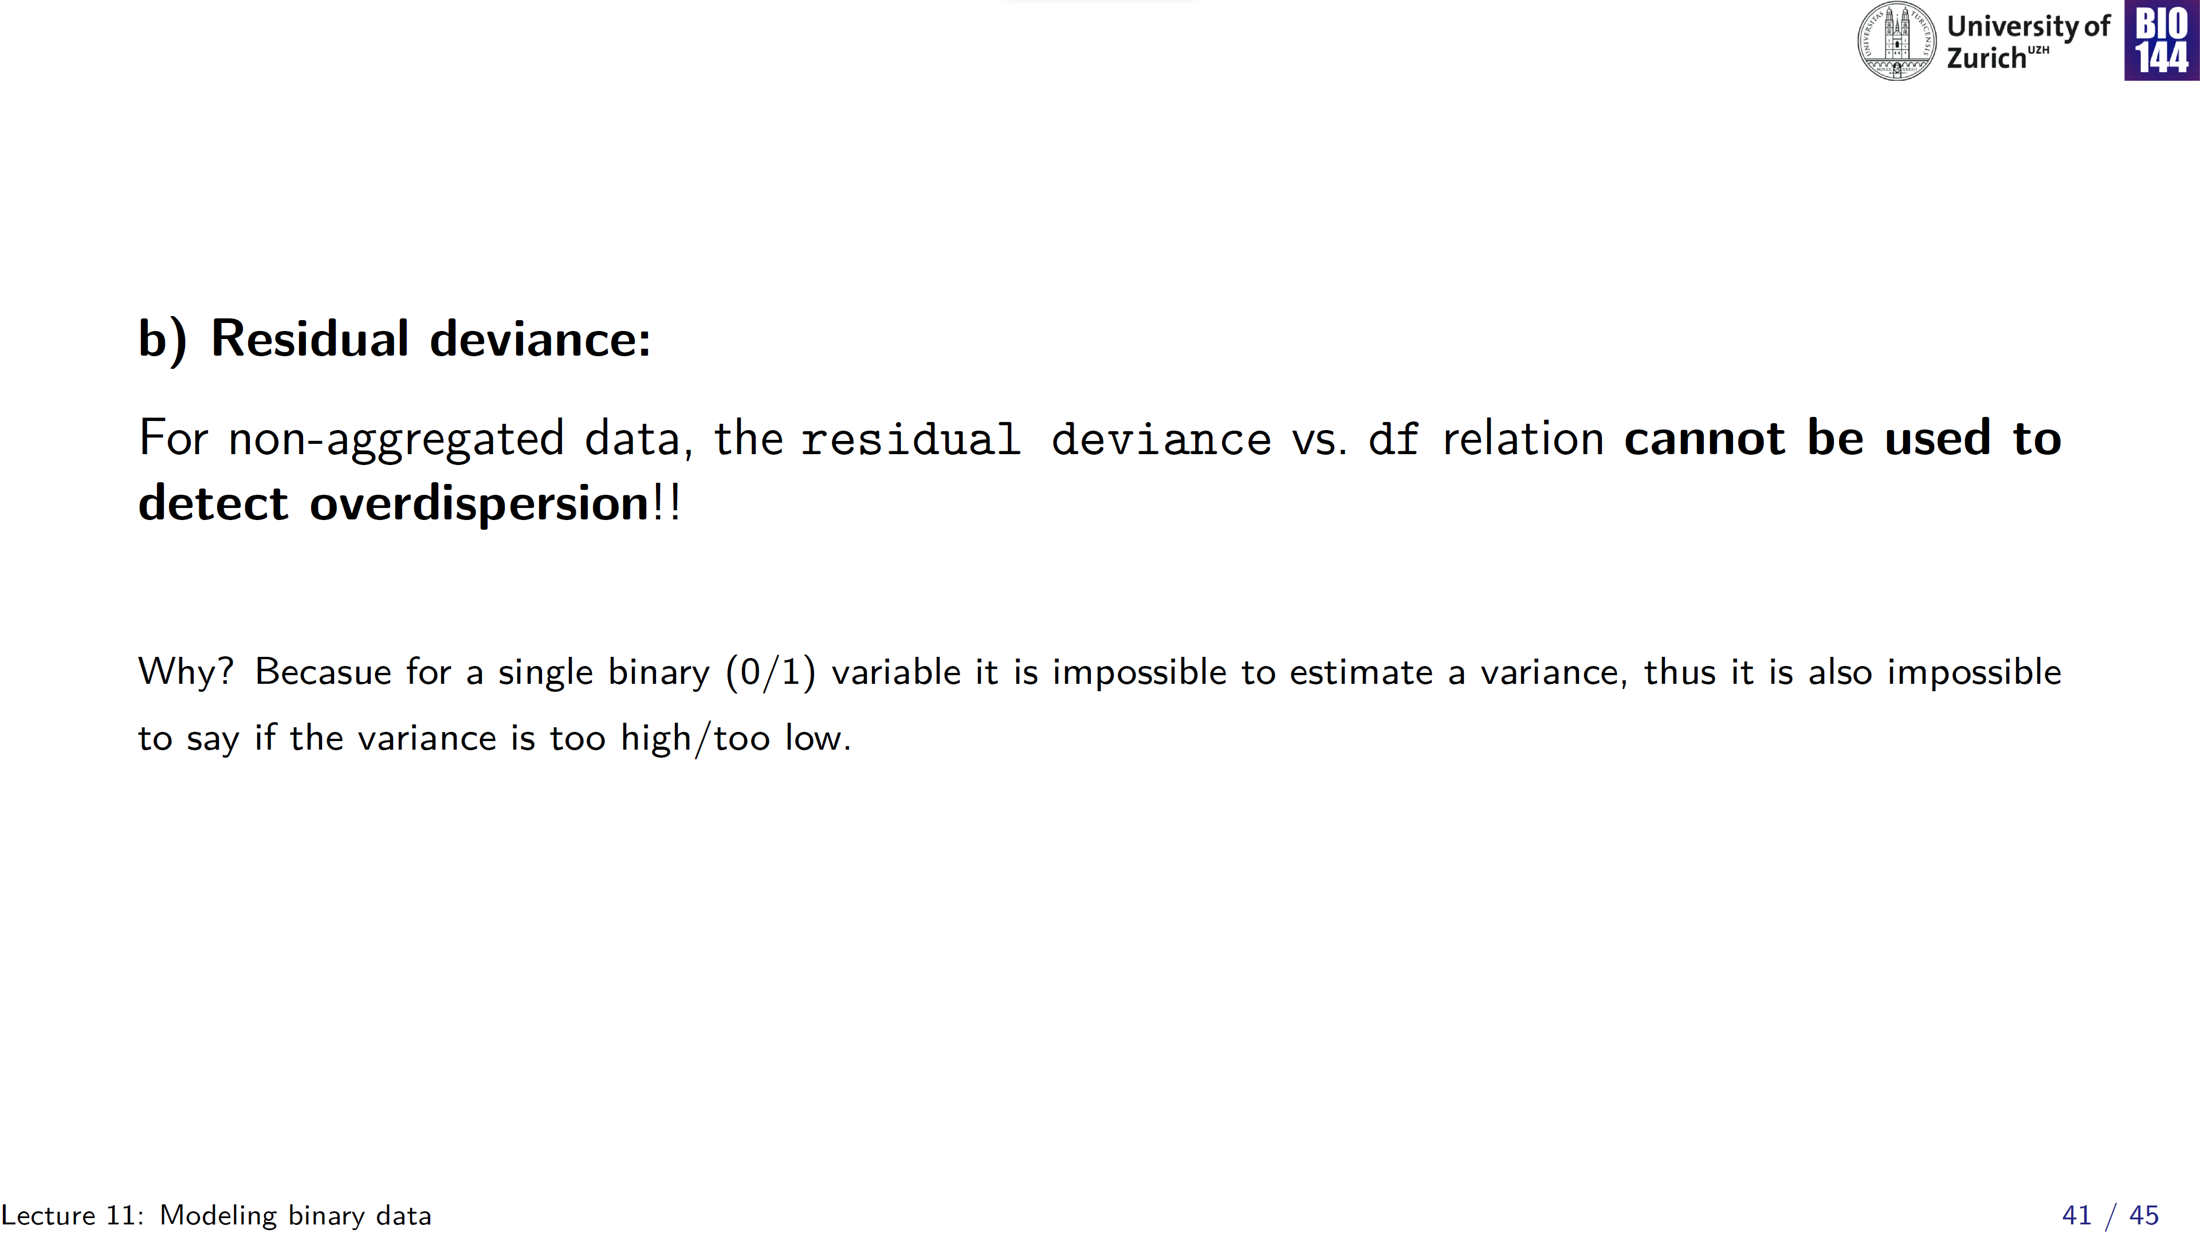
For binary outcome: over-/underdispersion is not an issue!

Slide 42
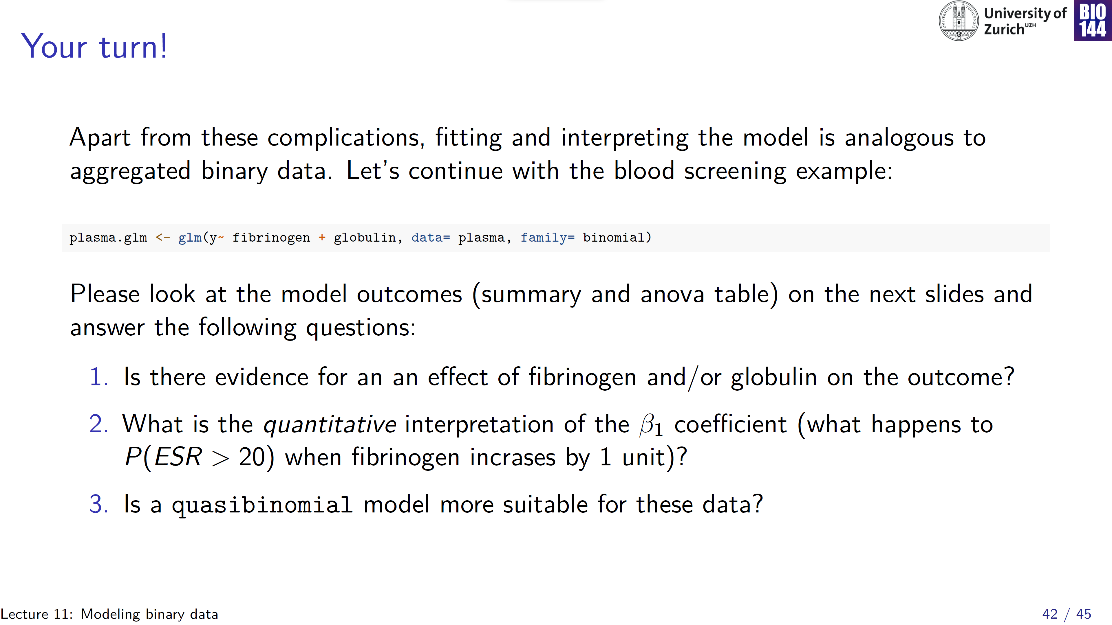
Notes:
Y is a vector of zeroes and ones

Slide 43
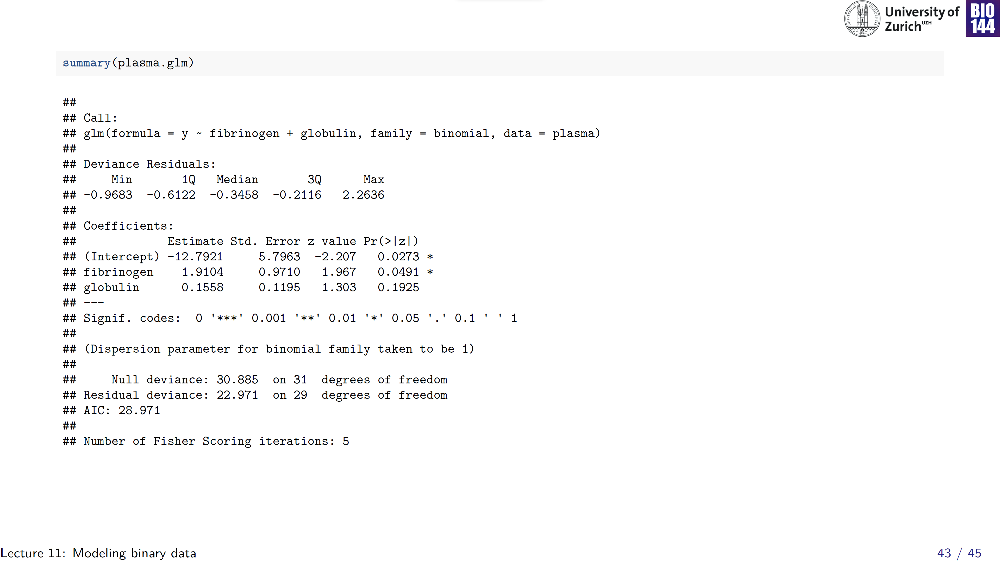
vector of 0/1
An increase in fibrinogen by 1 unit, is associated with an exp(1.91)= 6.7 times increase in the odds of being unhealthy
Cannot be interpreted (y is binary!)
Notes:
Remember, success was scored as Erythrocyte sedimentation rates greater than 20m, so being unhealthy!

Slide 44
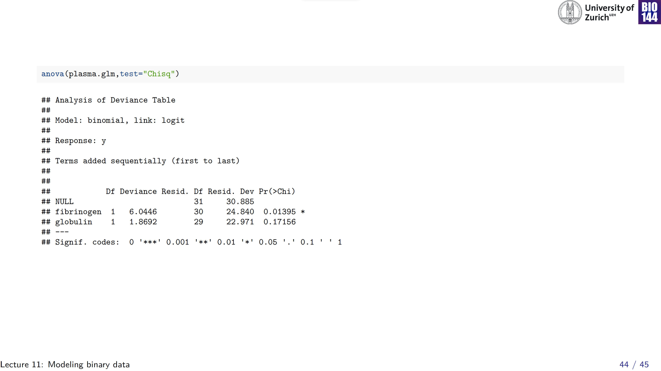

Slide 45
